Slide 1
Agile Perspective and the
Future State of Army ERPs
DISTRIBUTION STATEMENT A. Approved for public release: distribution unlimited.
May 14, 2024

Slide 2
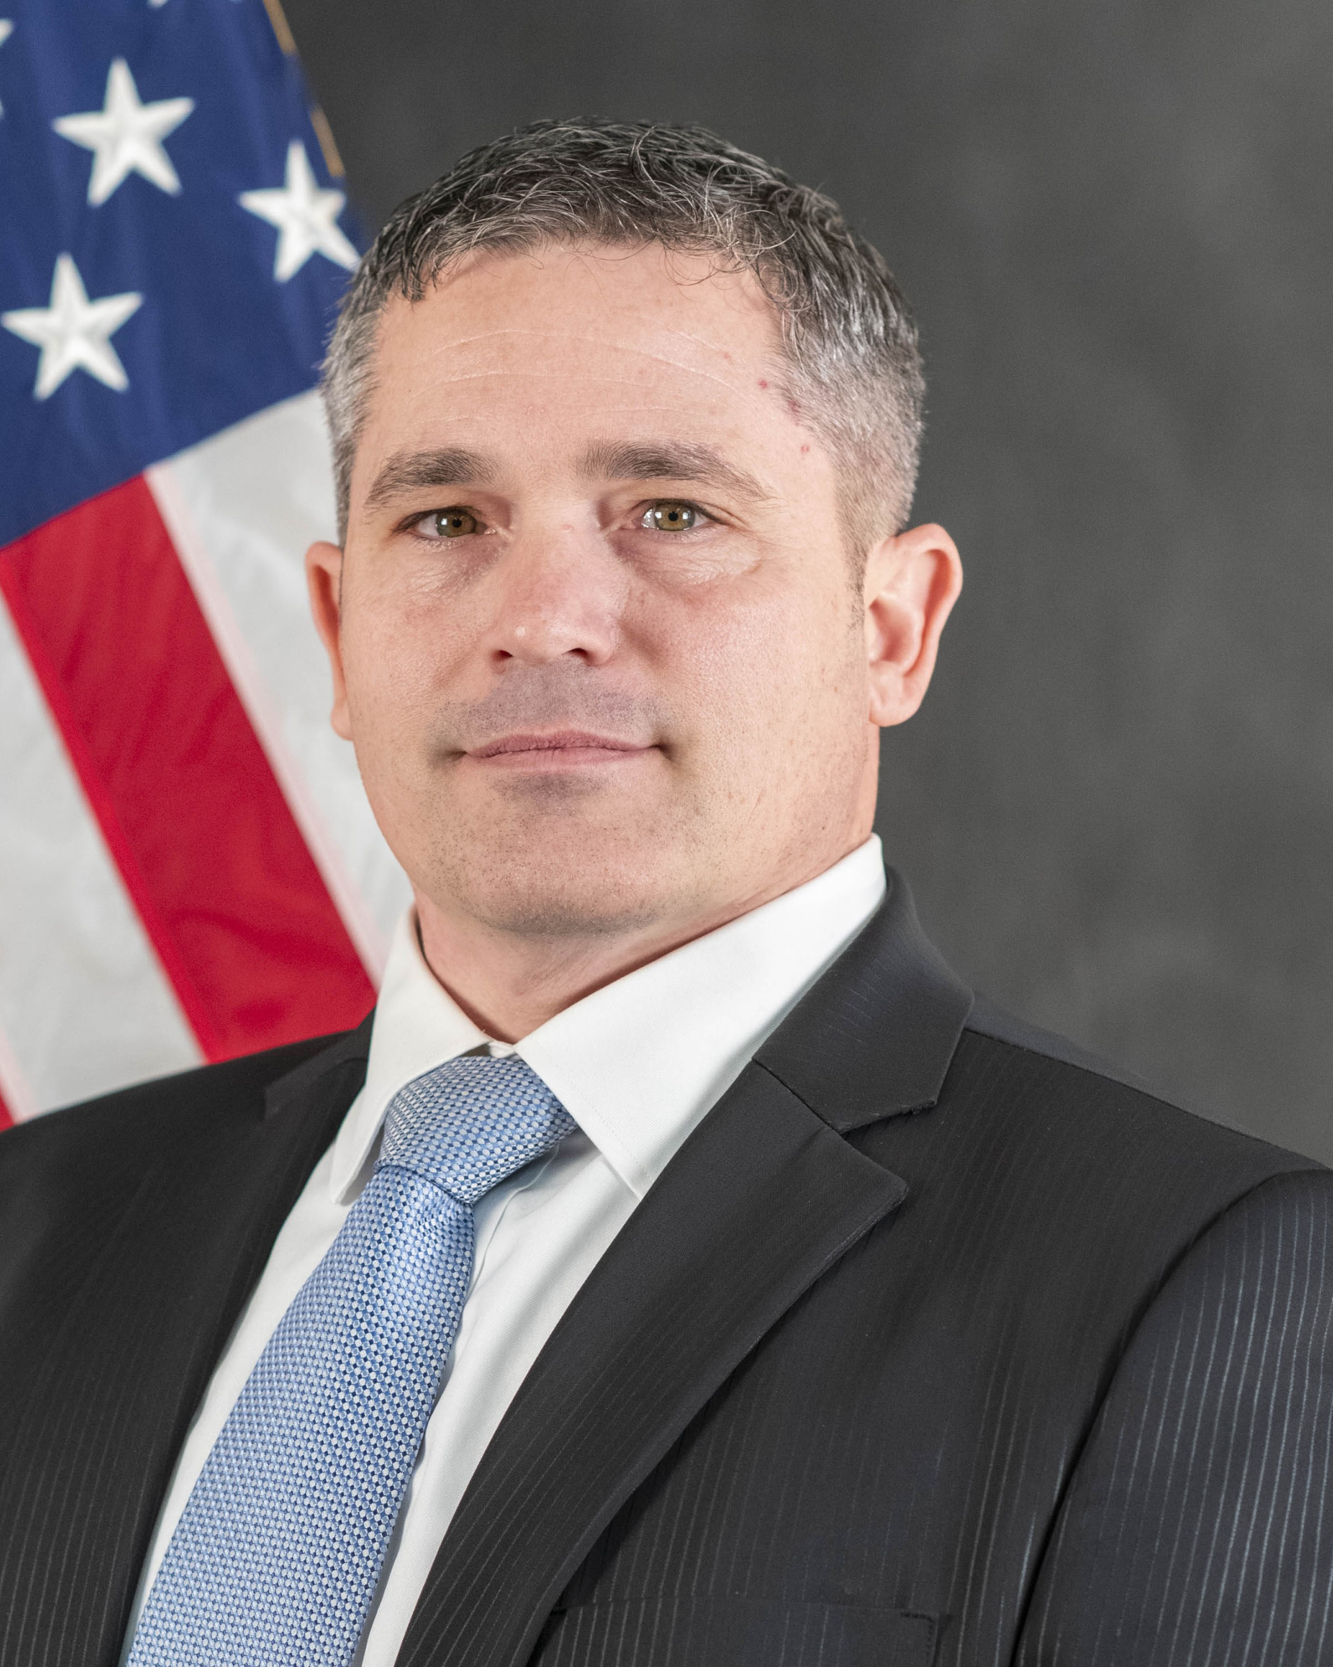
ENTERPRISE BUSINESS
SYSTEMS – cONVERGENCE
Enterprise Business Systems – Convergence (EBS-C) is the Army’s business modernization and transformation effort to simplify, streamline, standardize and unify business operations while improving auditability.
ACTING PROJECT MANAGER
MR. MICHAEL GORMLEY

Slide 3
Agenda
Update on the EBS-C Project
How agile practices are shaping the EBS-C solution

Slide 4





Who We Are
As Commercial as Possible
As Military as Necessary
BY THE NUMBERS
More than 200K unique users across all major Army commands
24 major Army capabilities across
the finance and logistics enterprise will
be integrated
5 ERPs systems will converge into
one modernized solution with an
SAP S/4 HANA core
Agile Approach
EBS-C is one of the PEO EIS programs that is using agile acquisition and software development approaches.
Business Process Re-engineering
The EBS-C Multi-functional Capabilities Team (MFCT) led by the Army’s Chief of Ordnance is partnering with more than 400 Army-wide stakeholders across the finance, logistics, human resources, and acquisition communities to identify common processes and areas for process improvement that the PMO will use to develop a technical solution.
Human Centered Design
EBS-C will deliver a human-centered user experience that will simplify workflows and implement intuitive hardware and software user interfaces.
WHAT WE DO
EBS-Convergence will provide sweeping improvements to Army enterprise business processes.
Specifically, it will: ​
• Implement a modernized approach
to Army business processes through
re-engineering
• Provide force planning, equipping, readiness, and deployment capabilities
• Enable procurement, human resources, technology, and finance activities
Converging Systems
The systems being consolidated include the Logistics Modernization Program, General Fund Enterprise Business System, General Funds Enterprise Business System – Sensitive Activities, Global Combat Support System-Army, and the Army Enterprise Systems Integration Program Hub.
Other Transaction Authority (OTA)
The EBS-C OTA mitigates risk by assessing the viability of software solutions to meet the EBS-C mission using prototyping. This sets the conditions to working in an agile environment with continuous integration and continuous delivery to rapid deploy capability to soldiers and civilians.

Slide 5

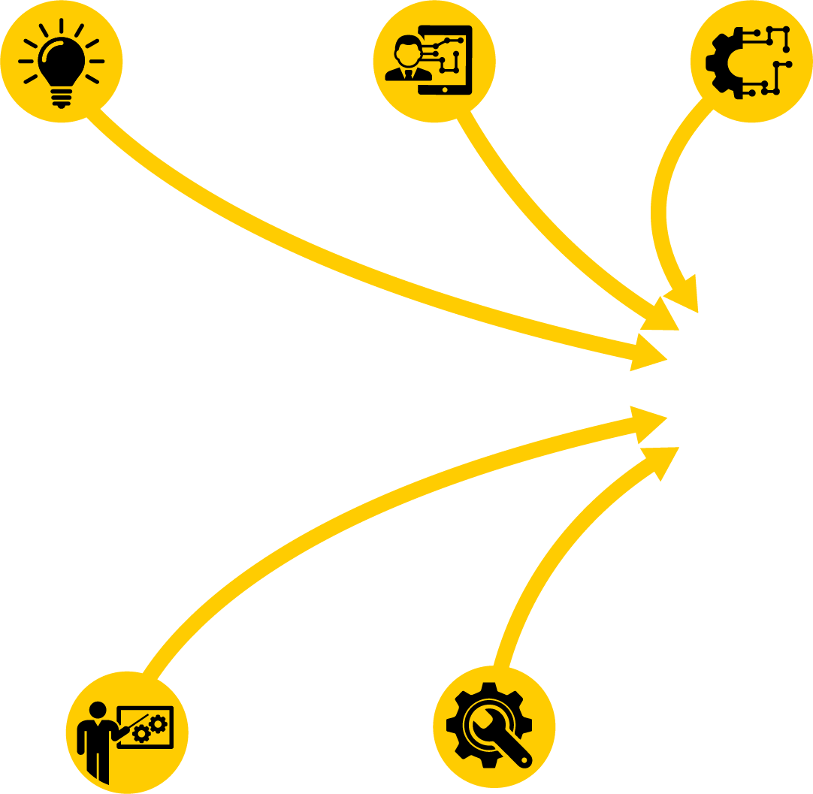






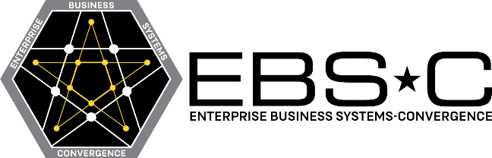




EBS-C Problem Statement
The Army’s business modernization and transformation effort providing a modernized warfighting capability that enables integrated and auditable sustainment operations from the strategic support area to the tactical edge of the battlefield, enabling decision making by Soldiers, the civilian workforce, and leaders at echelon.
HUMAN-CENTERED DESIGN
INSPIRATION
INNOVATION
Analysis
Define
Requirements (CRD)
Conduct
Fit to Standard
Agility Layer Applications (Including Best of Breed Systems)
ENDURING SYSTEMS
Enterprise Data Integration Platform (EDIP) Bridging Strategy
Agile Dev /
Business
Process
Re-engineering
Enterprise Data Integration Platform (EDIP)
Other
DBSs
Core Transactional System
Prototype
Standardize
Design
Finalize
Scope
SUSTAINABILITY
EFFICIENCY
ACWS = Army Contract Writing System
AESIP Hub = Army Enterprise Systems Integration Program Hub
AIE = Accessions Information Environment
CRD = Capabilities Requirements Document
DBS = Defense Business Systems
GCSS-Army = Global Combat Support System-Army
GFEBS = General Fund Enterprise Business System
GFEBS-SA = GFEBS-Sensitive Activities
IPPS-A = Integrated Personnel and Pay System
LMP = Logistics Modernization Program
HIGH LEVEL OUTCOMES
_{HLO 1 – Improve}
_{Readiness}
_{HLO 2 – Improve ROI and}
_{Total Cost of Ownership}
HLO 3 – Compliant Effective and Efficient Processes
HLO 4 – Timely, Secure, Protected, Accurate & Available Data
_{HLO 5 – Improve User}
_{Experience}

Slide 6




EBS-C Project Management Office (PMO) Update
Until March 2024, the PMO operated at reduced capacity due to Continuing Resolutions as a 'new start' program
  Ensured continued support for Other Transaction Authority (OTA) steps and demonstrations
  Executed with limited project management office (PMO) support and cloud services
  Experienced only minor delays to the overall OTA schedule
  Final OTA award is now scheduled for August FY24
Request for Information will be released this Spring for a Technical Services Contract
Complete
On Track
On Track
Upcoming
Upcoming
OTA Step 5 kicked off on 1 APR with two vendors
Providing vendors with final Performance
Work Statement (PWS) supporting Step 7 award
Continuing Step 5 prototyping with focus on Human Centered Design and Data Integration
Step 7 upward invite anticipated approximately 16 AUG
Technical Services Contract RFI and RFP Release

Slide 7



OUR THREE PILLARS
SPEED
SIMPLICITY
EXCELLENCE
Become Agile Practitioners to deliver earlier, faster and
more frequently
Decompose, streamline, simplify, and remove programmatic clutter
Deliver better quality by testing every sprint, engaging customers earlier and using automated testing

Slide 8
EBS-C & Agile

Slide 9




EBS-C PMO Agility Unifies EBS-C Activities
Organization
Acquisition Strategy
Contracting
Software Delivery
  Lean Governance:
    Leverage the Tri-Chair Governance Review Panel
    Have tight integration with the functional business owner
    Make decisions at the lowest possible level
  Establish Lean Agile Center
  of Excellence to provide
  skilled resources, scrum teams, and a standard cadence for all activities
  Use the 5000.87 Software Acquisition Pathway
  Incorporate the ability for requirements to change
  Decompose into small increments
  Involve soldiers and
  civilians throughout
  Provide rapid delivery
  to the users through frequent releases
  Leverage Other Transaction Authority (OTA) for speed and prototyping
  Collaborate with the Army Contracting Command to reduce acquisition lead times
  Expand evaluation criteria to include proof of concept in cArmy environments
  Utilize Scaled Agile
  Framework methodologies
  Minimize customization; Commercial as Possible, Military as Necessary
  Utilize 10-week Planning intervals to stay in synch
  with functional stakeholder
  and the Technical
  Integration Provider
  Integrate and automate
  testing throughout the
  software lifecycle

Slide 10
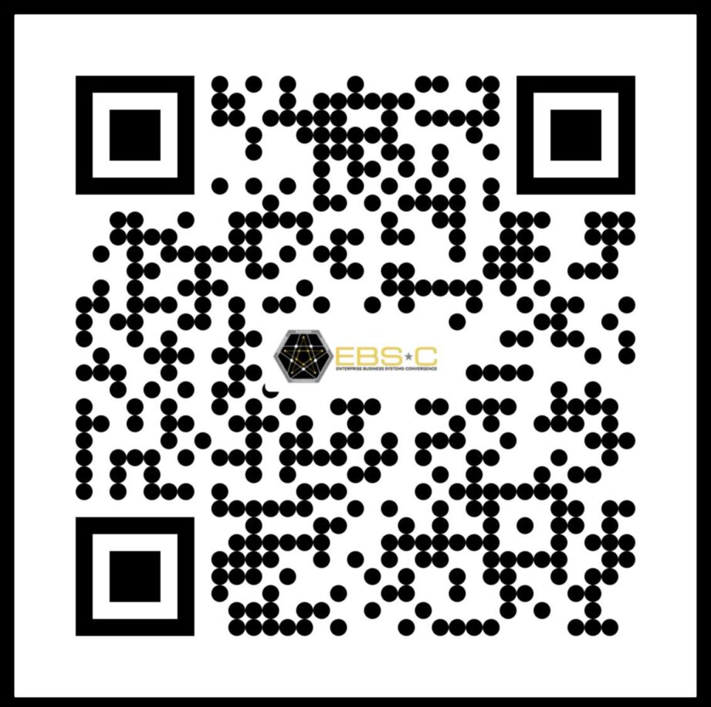




THE ARMY RELIES ON PEO EIS
COMPANY/USARMYPEOEIS
PEO.EIS
@PEOEISPAOFFICE
WWW.EIS.ARMY.MIL
@USARMY.PEOEIS

