Slide 1
COMPUTER HARDWARE, ENTERPRISE SOFTWARE, AND SOLUTIONS - CHESS
ITES-4S PANEL DISCUSSION
Connecting the future Soldier with technological resources for information dominance.
DISTRIBUTION STATEMENT A. Approved for public release. Distribution is unlimited

Slide 2





ITES-3S OVERVIEW
INFORMATION TECHNOLOGY ENTERPRISE SOLUTIONS
*Mandatory commercial IT services contract for the Army | Full range of innovative, world-class IT support services and solutions
No Contract Usage Fee – Open to all DoD And Federal – Decentralized Ordering – Technology Refreshment – No Protests < $25M
2 HUBZone – 7 Service-Disabled Veteran Owned Business – 25 Women Owned Small Business – 2 Small Disadvantaged Business
OVERVIEW
116 Prime Contract Holders
65 large business
51 small business
$12.1 Billion ceiling across all contracts (including all options)
SCOPE
The ITES-3S solutions are categorized by task areas. Subdivided into subtask areas that further define the scope (CONUS & OCONUS)
PERIOD OF PERFORMANCE
Currently in Option Period
25 SEP 2018 to
24 SEP 2027
ORDERING
Request for proposal (RFP)
Small business set-asides
NAICS code(s): 541519
Notes:
Stacy

Slide 3

RS3 OVERVIEW
RESPONSIVE STRATEGIC SOURCING FOR SERVICES
Largest contract within ACC and successor to five expired MA IDIQ vehicles
$37.4B Multiple Award Indefinite Delivery, Indefinite Quantity Contract for knowledge-based professional services
Government-Wide Acquisition Contract – Authorizes within-scope use and possible Delegated Procurement Authority to all Federal Agencies
OVERVIEW
158 Prime Contract Holders
45 large business
113 small business
$37.4 Billion ceiling across all contracts (including all options)
SCOPE
C5ISR related knowledge-based professional support services
(Engineering; Research, Development, Test & Evaluation; Logistics; Acquisition and Strategic Planning Services; and Education and Training Services)
PERIOD OF PERFORMANCE
Currently in Option Period
15 MAY 2022 to
14 MAY 2027
ORDERING
Request for proposal (RFP)
Task Orders placed before the end of the ordering period may go until 14 May 2032
NAICS code(s): 541715
Notes:
Matthew

Slide 4
ACCESS/ITES-4S COMPARISON
Area of Focus | ACCESS | ITES-4S
Mission Partners / Open to | Army, DoD, and other federal agencies | Army, DoD, and other federal agencies
Primary Service Area | Knowledge-based professional support services/Staff Augmentation: (Expand to include other functional areas like IT and Medical-based logistical services) | Cyber-Security Services, Program Management Support, IT Services, Business Process Reengineering, Enterprise Design, Integration, & Consolidation, Network/Systems Operation & Maintenance, Telecommunications/Systems Operation & Maintenance, Data Services, Intelligent Automation, Cloud (Additional TBD)
Evaluation Criteria | Streamline Evaluations: -Scorecard/Possible Self Evaluation -Evaluate Cost at TO level | Scorecard, self evaluation, strict compliance, limited awardees, price is not the most important factor
NAICS | Potential expansion beyond single NAICS Codes | 541519 – Other computer related services Additional NAICS Codes (TBD)
Notes:
Ashley

Slide 5
ACCESS/ITES-4S Comparison (Cont.)
Area of Focus | ACCESS | ITES-4S
Business Type | Large and Small (Including VOSB/SDVOSB, WOSB, SDB, HUBZone, etc.) | Small business reserved awards to include 8(a), SDVO, WOSB, HUBZone
Ordering Period | Initial five (5) year base ordering period followed by a single five (5) year optional ordering Period | Initial five (5) year base ordering period followed by a single five (5) year optional ordering Period
Ceiling | TBD – Planned $37.4B+ | $12B (TBD)
Contract Type | MA IDIQ: Allow for utilization of all contract types at the TO-level | MA IDIQ: TOs include FFP, T&M, cost reimbursement, hybrids of all
Notes:
Ashley

Slide 6
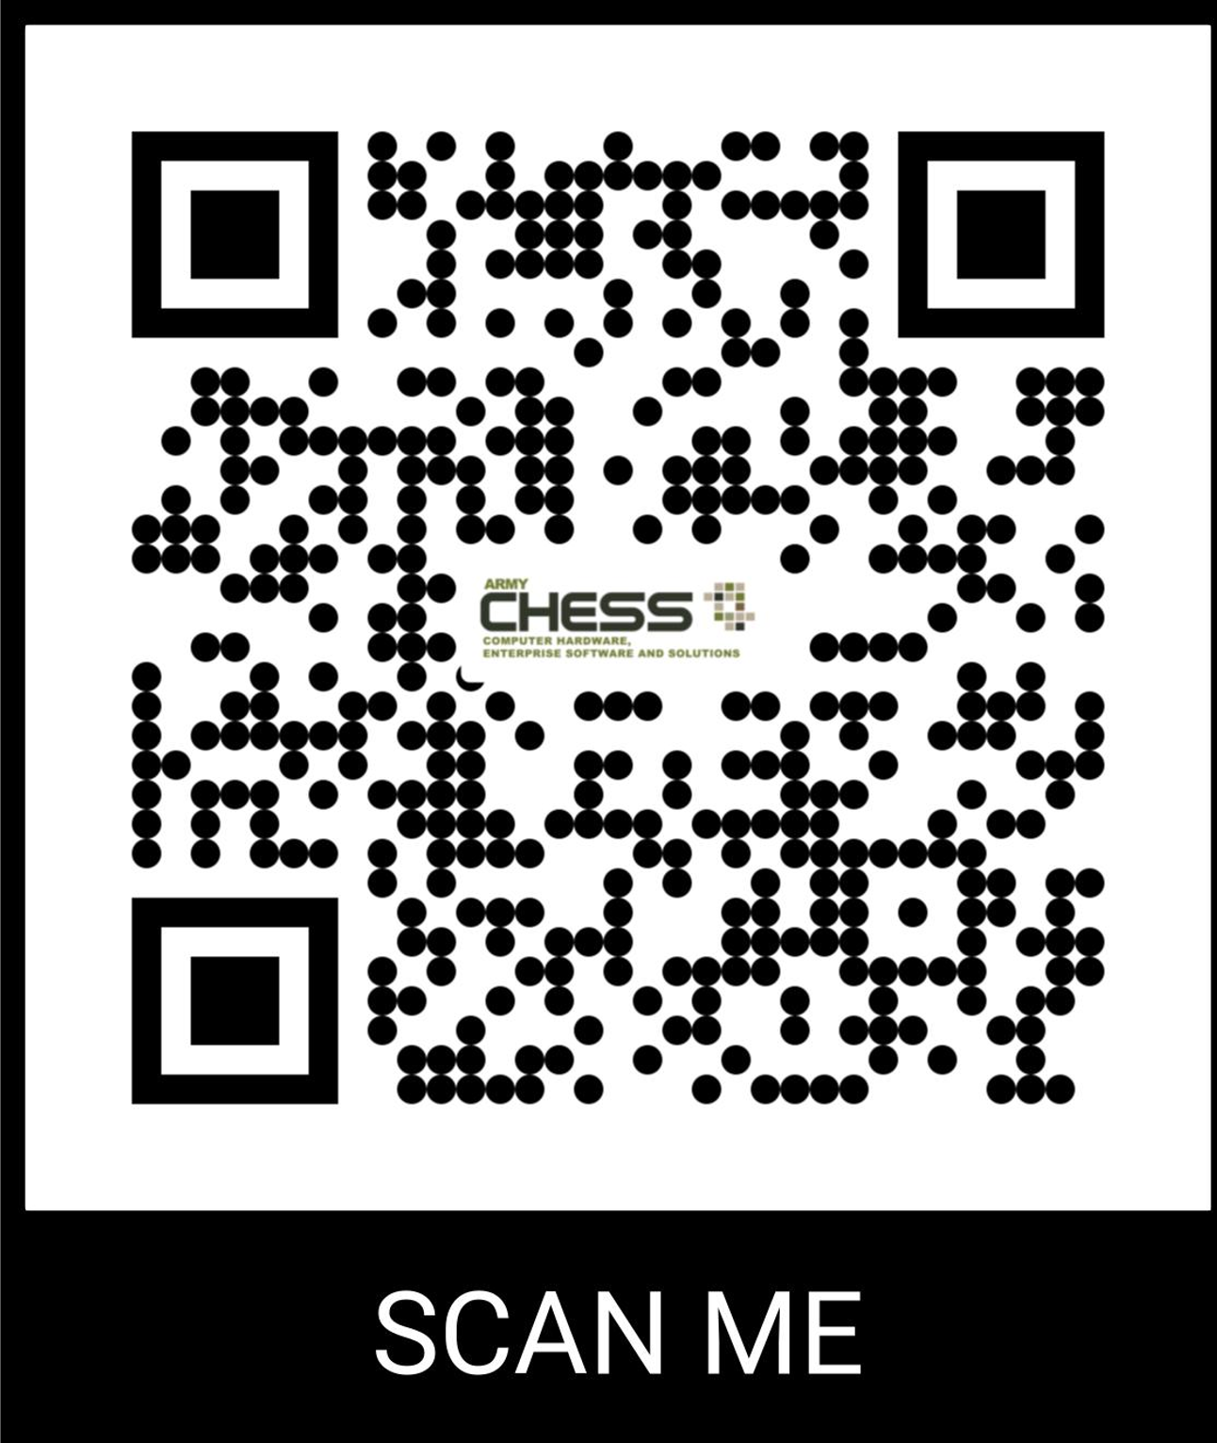

CONTACT US
10119 BEACH ROAD
BUILDING 322
FORT BELVOIR, VA 22060
CHESS.ARMY.MIL
ARMYCHESS@ARMY.MIL

