Slide 1



MR. SERGIO ALVAREZ (presenting on behalf of Mr. Boyd Williams)
PRODUCT DIRECTOR, ALTESS
ALTESS OVERVIEW
Military-strength data security, solutions, and support for your most critical applications.
DISTRIBUTION STATEMENT A. Approved for public release. Distribution is unlimited
May 14, 2024

Slide 2
AGENDA
Delivering Secure, Trusted Technology
History and by the Numbers
ALTESS Continuous Evolution
ALTESS Customers
Army Edge Computing Capability
  Former and Transitional State
  USARPAC MVP
Future Initiatives and Opportunities

Slide 3


ALTESS DELIVERS SECURE, TRUSTED TECHNOLOGY
ALTESS provides the Army unique, unmatched advantages globally:
We are an Army-owned, Army-operated Technology Service Provider with global reach that puts Army Mission first.
We offer transparency and security commercial cloud companies cannot because we own the entire IT stack.
We offer complete end-to-end mission IT enablement with ready-now services including ISP, ASP, MSP, Help Desk, etc.
We are uniquely located and built to keep running under the Appalachian mountains in the heart of Hokie Tech corridor.
We create a unique best-of-breed model by pulling from the best of industry, integrators,
and Army.
TRUSTED BY OUR CUSTOMERS:
Selected by IEN in 2023 to be the Army’s sole trusted technology and service provider for the backbone of future modern warfare.
USAF/AMC recently (2023) selected ALTESS’ unique facility design and location.

Slide 4



HISTORY AND BY THE NUMBERS
ALTESS will continue to evolve its services to deliver whatever the mission requires. Army first.
Transformation
2003
2010
2018
2022
Future
.
.
.
.
.
.
.
.
Traditional Footprint
Single site
Hardware focused
Hosting 20 applications
People and Process Initiatives
  Virginia Tech and Radford University Interns
  Reimbursable Cost Model
  ITIL implementation
Virtualization focused
Infrastructure upgrades
Hosting 50+ applications
Established the first Common Services in the Commercial Cloud for the Army in 2018
  Currently Providing Managed Services to 135 in cArmy
Established the foundation for Army Edge Computing Capability (AECC) (2 Sites Operational – Ft. Liberty and Radford) Servicing 119 applications.
Expand AECC in 2024 / 2025 (Graf, JBLM, USARPAC)
Architect the Army Edge Computing Capability
Migrate additional applications into cArmy and to AECC locations

Slide 5
ALTESS’ CUSTOMERS
ALTESS supports a wide range of use cases and customer services:
Migration to all Clouds (135 Managed Systems)
54 AMC systems from the closing DISA MilCloud 2.0 to cARMY Azure (<3 months)
81 HQDA systems from JSP Pentagon to ALTESS Azure (< 6 months)
Architecture Modernization
Compute & Storage Services
79 Programs with 119 Managed Systems
Radford and Ft. Liberty locations (NIPR & SIPR)
  1,569 Windows and Linux Servers Managed
  2.87 PB Storage
Grafenwohr SIPR and JBLM NIPR (New Deployments – To Date)
  79 Windows and Linux Servers
  276 TB Storage
Unique On-Prem Optimization Requirements
Army Edge Computing Capability (PM IEN)
  Army Owned/Operated
  Hosted In-Theater
  Multi-site Redundancy
  DDIL Resilient
Future Hybrid Optimization
  Azure Stack, AWS Outpost, Oracle @Customer, Google Distributed Cloud Edge
Prototype Support (“make it work” requirements)
Army Leadership Dashboard (ALD) / Vantage
Commercial Solutions for Classified (CSfC) Verizon
Army Futures Command (AFC) Modernization and Application Data Environment (MADE)
Army Software Factory

Slide 6
Army Edge Computing Environment (AECC)
Former State (Army Enterprise Data Centers)
Traditional Army data center (not interconnected)
Only supported enterprise applications, hoteling, etc.
Costs were not attributable or actual to the application or system
AECC Global Footprint
Transitional State: Army Edge Computing Environment
Fielded (or fielding) at selected AEDC locations (2 at Full
operational capability at Radford, VA and Fort Liberty, NC).
(JBLM and Graf slated for 2024)
Common, compute and store platform (NIPRNet and SIPRNet)
Supports Army Data Center Consolidation and Army Data Plan efforts
Leverages ALTESS (DASA-CE approved) cost model, contract, and contract-based requirements to standardize AEDCs
Scales and reuses processes and technologies from ALTESS
Remotely monitored and managed from ALTESS
  Data Center Infrastructure Management (DCIM) Tool
Active
Next 6 months
Planned

Slide 7
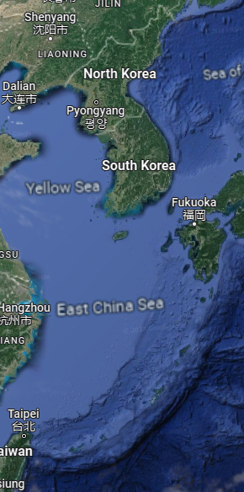
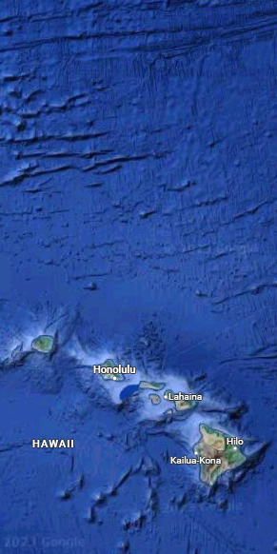
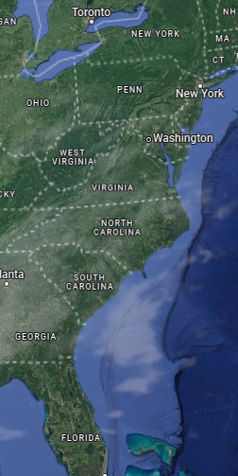
ARMY EDGE COMPUTING CAPABILITY – PAC MVP
Key Features:
Army Owned/Operated
Centrally Funded
Hosted In-Theater
Multisite Redundancy
Scalable Capacity
DDIL Resilient
FOC Capabilities:
Server & Container hosting
DevSecOps Platform
Shared Common Services
Collaboration Services
Capacity (per site):
2000 vCPU
3 PB Storage
Workloads:
CPCE
LOGCOP
AFATADS
Master Data Node
PCOP
Future Capabilities:
MPE
Data Services
cARMY Integration
Cross Domain Solutions
PaaS
Location: Fort Shafter, HI
Network: SIPR
Capabilities: IaaS, Containers, DevSecOps, Common Services
Location: Camp Humphreys
Network: SIPR
Capabilities: IaaS, Containers, DevSecOps, Common Services
Location: ALTESS Radford
Network: SIPR
Capabilities: Management, Monitoring
10 Dec 2023
Hardware Received
(ALTESS)
15 Dec 2023 – 15 Apr 2024
Build AEPC Stacks
(ALTESS)
30 Apr 2024
Ship AEPC Stacks
(KOR, HI)
01 June 2024
MVP IOC
15 Aug 2024:
Additional Capabilities
30 SEP 2024
MVP FOC

Slide 8
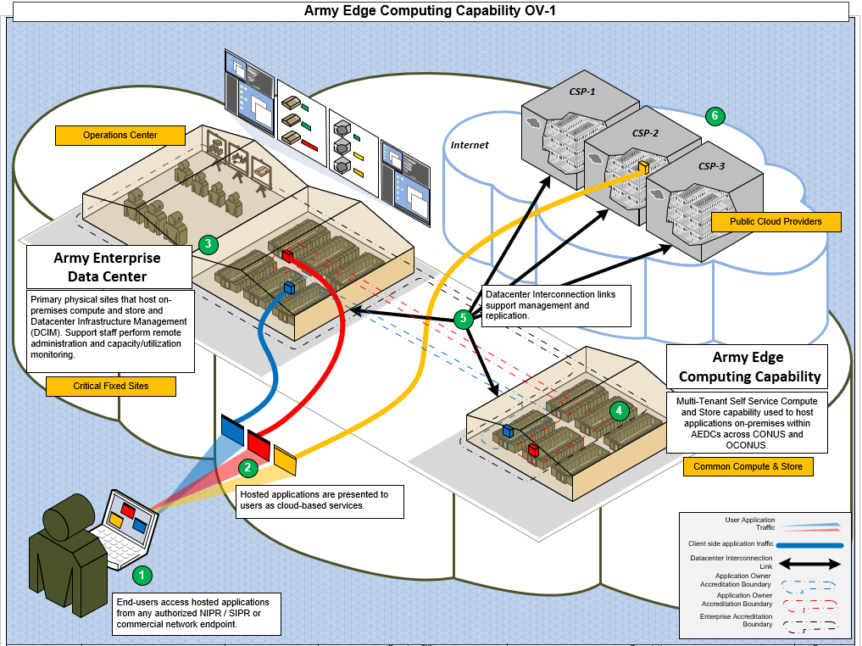

Slide 9
FUTURE INITIATIVES AND OPPORTUNITIES
Army Software Factory – Deploy node at Radford
  VMware Tanzu Containers (Kubernetes)
  Army Software Factory Dev-Sec-Ops Pipeline
PEO C3T – PM Mission Command and PM Tactical Networks
  Migrate BFT Global Network (BGN) Ft. Hood Operations Center (BGN3) to Radford
  Master Data Node – fulfill persistent data requirement on the battlefield
  Integrate Radford data center with tactical network via PM TN GAIT node
Application Modernization
  Assist application owners' modernization efforts – more PaaS utilization
Host Rapid Prototype Development Environment
  Ability to rapidly field ASA(ALT) and Army IT prototypes with minimal standup effort at Radford

Slide 10
BACKUPS

Slide 11



ALTESS SERVICES
Value Added
Centralized Infrastructure, Platforms
and Tools
Consistent Service Management Processes
Modernized Applications
Centralized Management of Platform and Workload
Perf. and Capacity Mgmt. to ensure service availability
Standard Code Development Framework
Consistent and Reliable Infrastructure
Standardized Service Definitions
Application Architecture & Design
Scalable Infrastructure
24 x 7 x 365 Service Desk
Improved Reliability, Scalability
and Security
IaaS, PaaS, SaaS Services
Centralized Service Catalog
Application Assessment and Enhancement
Consolidation of tools, provisioning processes and effort
Professional Services, Consulting
and Support
Agile Code Development and Delivery
High Availability
Cyber-Security and Compliance Services
Application Lifecycle Management
Proactive monitoring and analytics
Shareable Knowledge Base
Application Troubleshooting and Remediation
Infrastructure Service Provider
Managed Service Provider
Application Service Provider

Slide 12
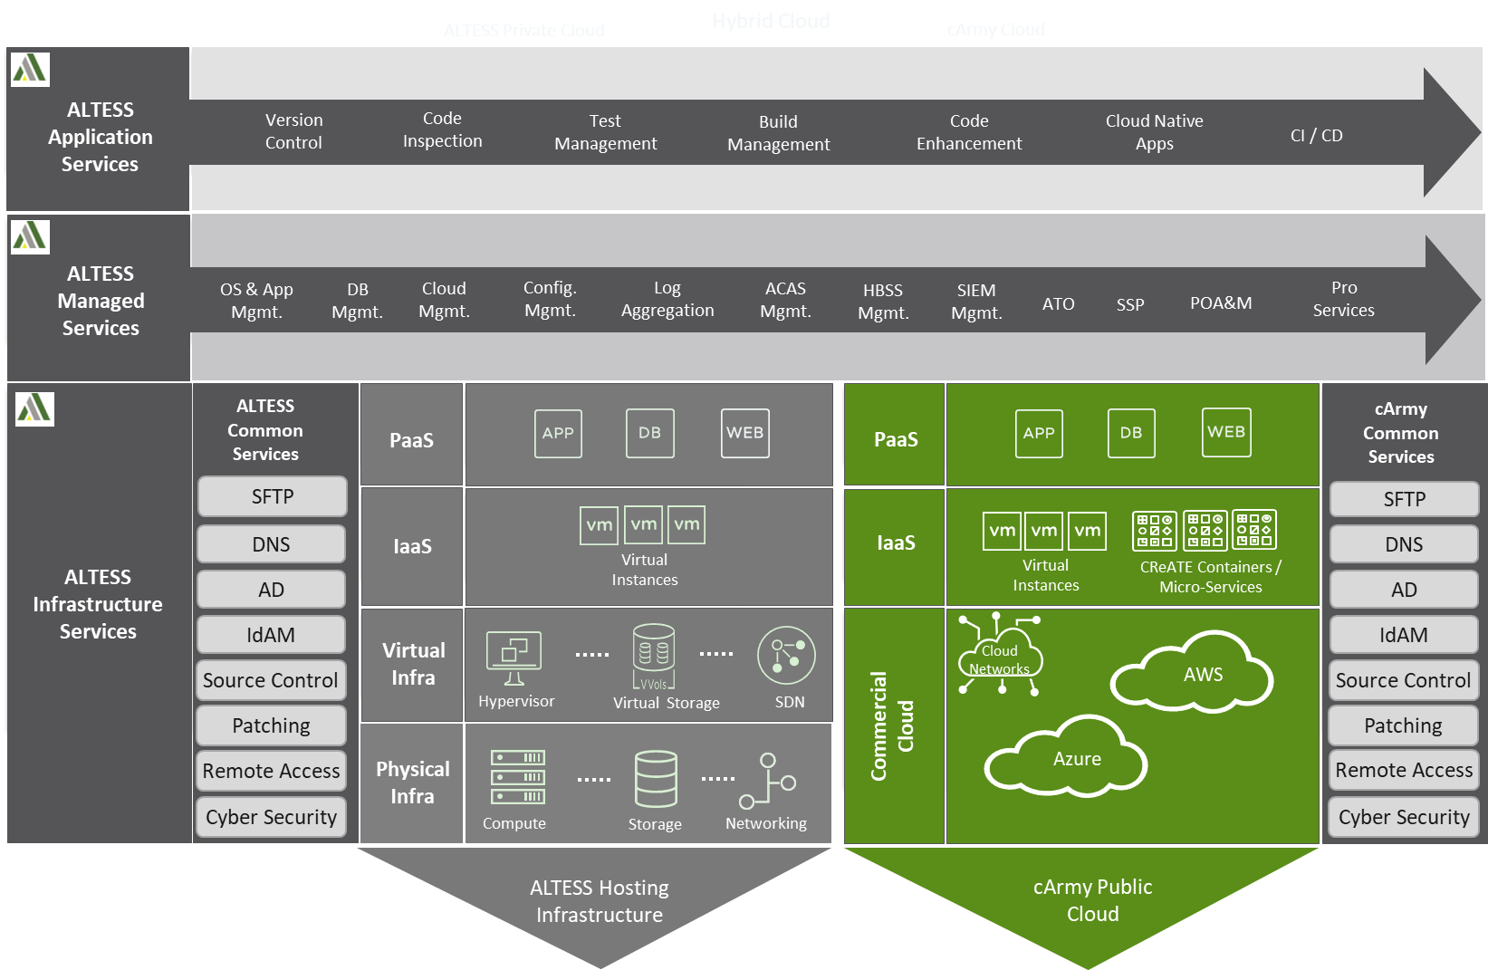
ALTESS SOLUTIONS

