Slide 1



Logistics Information Systems (LIS)
AFCEA Breakout Session
Elissa E. Zadrozny, Product Lead
May 15, 2024
DISTRIBUTION STATEMENT A. Approved for public release. Distribution is unlimited

Slide 2



OUR THREE PILLARS
Speed
Simplicity
Excellence
Become Agile Practitioners to deliver earlier, faster and more frequently
Decompose, streamline and simplify. Remove programmatic clutter
Deliver better quality by testing every sprint, engaging customers earlier and using automated testing
Notes:
Use the wheel to focus on each item

Slide 3






MISSION AREAS
DATA
HUMAN CAPITAL
LOGISTICS
We make data visible, accessible, understandable, trusted and interoperable.
We support Soldiers through acquisition programs, medical communications and more.
We provide detailed coordination of the people, facilities and supplies within the Army.
ENTERPRISE SOFTWARE & SERVICES
FINANCE AND ACCOUNTING
FORCE MANAGEMENT
We develop software applications and provide IT services that continuously transform and modernize the Army.
We deliver the Army's financial and contracting solutions and ensure audit readiness.
We support Army readiness on a global scale, providing data critical to managing force structure and foreign military sales.

Slide 4
Breakout Session Ground Rules
This brief is marked “Distribution Statement A. Approved for Public Release, Distribution Unlimited.”
The Government will not publish Industry-Proprietary questions/comments or their responses.
Nothing presented in this Breakout Session commits the U.S. Army to any acquisition approach, agreement or contract.
All content presented here is tentative pending an Acquisition Strategy Decision from the Army Acquisition Executive.
Any future published opportunity will take precedence over information presented today or in response to questions.
Notes:
Use the wheel to focus on each item

Slide 5
Where We Need Industry Input
MODERNIZATION
  Cloud migration for LIS systems
  Agile adoption and implementation
  Logistics modernization strategies
  Production / supply line capability for IDIQ hardware
  Vendor engagement with RFI’s and RFQ’s
IDIQ = Indefinite Delivery, Indefinite Quantity LIS = Logistics Information System
RFI = Request for Information RFQ = Request for Quote
Notes:
Use the wheel to focus on each item

Slide 6


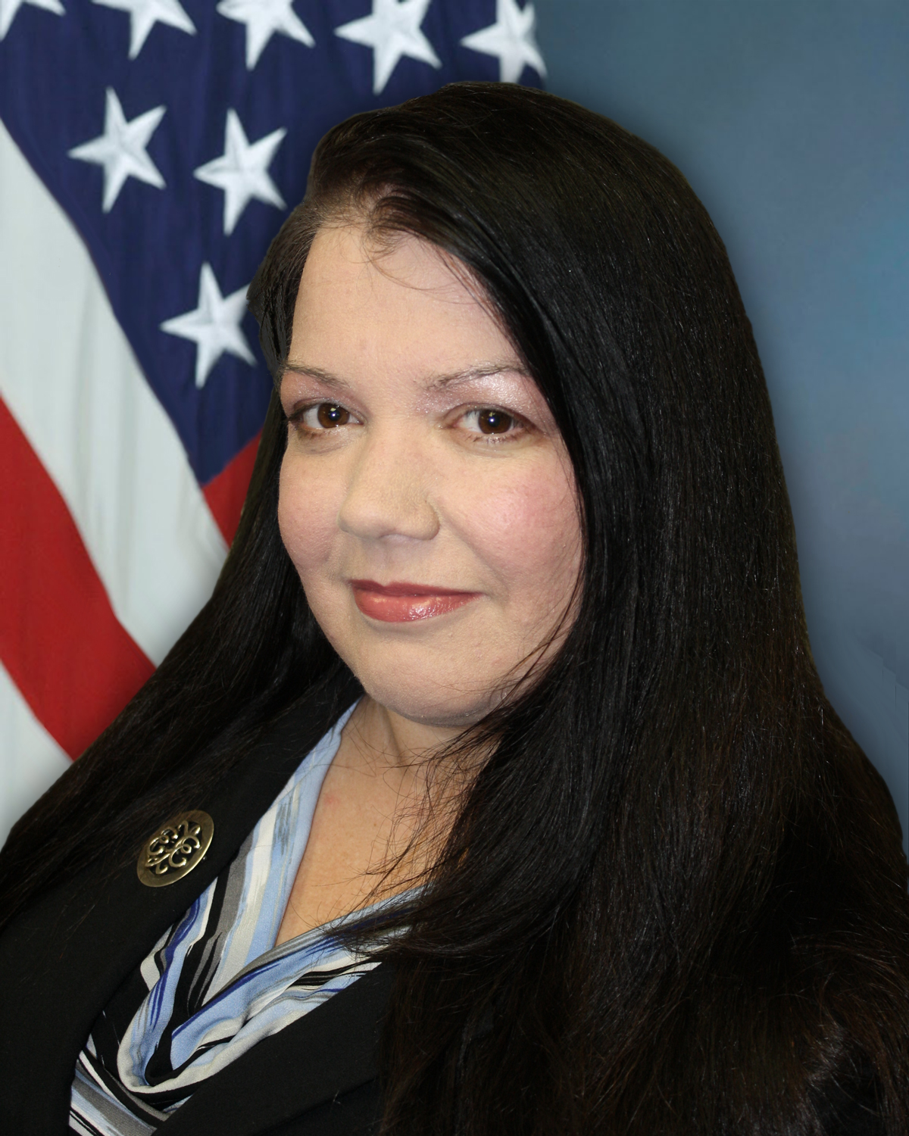
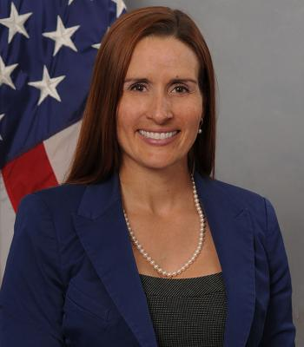
Organizational Chart
PEO EIS
Mr. Bill
Hepworth
PM ARDAP
Mr. Brian
Raftery
PL LIS
Ms. Elissa
Zadrozny
Systems
TC AIMS II
RF-ITV
SAAS
PBUSE
Supply Contracts
NGT
AIT
aRFID
Notes:
Use the wheel to focus on each item

Slide 7
Product Lead, Logistics Information Systems (PL LIS)
PL LIS is the Lifecycle Sustainment Manager for the Logistics Information Technology systems employed in every tactical unit and garrison logistics activity world-wide. PL LIS is responsible for maintaining Automated Information Technology (AIT) product procurement contracts for DoD.
Mission:
Responsible for acquisition program management and lifecycle sustainment within cost, schedule, and performance for assigned logistics information systems.
Support the integration of automated movement and identification technologies into Army & enterprise business processes.
“All U.S. Army organizations and activities will procure AIT products and services from PL LIS. Direct procurement of AIT products and services from commercial sources is not authorized. U.S. Army organizations and activities are encouraged to coordinate directly with PL LIS on any AIT initiatives and offer recommendations to include other value-added AIT products to contracts.“ – 02 June 2022 G-4 memo
Notes:
Use the wheel to focus on each item

Slide 8
Logistics Information Systems (LIS)
Systems | FY24 / 25 LIS Program Priorities
Radio Frequency In-Transit Visibility (RF-ITV) uses active and passive radio frequency technology for In-Transit Visibility (ITV) of unit moves and sustainment cargo. RF-ITV tracks the identity, status and location of cargo from origin to destination. Standard Army Ammunition System (SAAS) legacy system for tactical ammunition supply management. (Future transition to EBS-C estimated for FY27) | Release/Recompete 3 IDIQ Supply Contracts. Active Radio Frequency Identification 6 Automated Information Technology 7 Next Generation Transponder II Recompete SAAS PDSS Capability Support Contract. Safe Agile adoption strategy across all systems. Investigate transition from static servers to cloud based technology.
 | Software / Technology Stack
 | RF-ITV - n-tiered architecture base on Oracle Solaris technology hosted by DISA. SAAS: centralized server architecture hosted by ALTESS.
ALTESS = Acquisition, Logistics and Technology Enterprise Systems and Services
FY = Fiscal Year
PDSS = Post Development and Software Support
EBS-C = Enterprise Business Systems – Convergence
Notes:
Use the wheel to focus on each item

Slide 9
Standard Army Ammunition System (SAAS)
Overview:
SAAS is the Army’s automated retail ammunition logistics information system providing ammunition management, reporting, and accountability in both tactical and non-tactical environments.
SAAS operates at multiple levels including Theater Sustainment Command (TSC) Distribution Management Centers, Expeditionary Sustainment Command Distribution Management Centers and Ammunition Supply Activities.
Numbers:
136 locations worldwide
~ 600 active users
Under full Army mobilization SAAS supports up to 3800 users.
Services include:
User Account onboarding and management
System Administration
Database management
Cyber security/compliance
Network worthiness
Disaster Recovery Site (COOP)
Configuration Management
Software Engineering
Service Desk
Training Solution Support
System Architecture Support
Documentation
Challenges:
Agile Methodology Adoption
Future transition to EBS-C estimated for FY27
COOP = Continuity of Operations
TSC = Theater Sustainment Command
FY = Fiscal Year
EBS-C = Enterprise Business Systems – Convergence
Notes:
Use the wheel to focus on each item

Slide 10
RF-ITV IDIQ Supply Contracts
  Three years minimum warranty for equipment/software | Help Desk support (24/7) | Training | Maintenance | HERO Certified | EMI Certified | Delivery: 45/90 days CONUS/OCONUS
  aRFID
  Active Radio Frequency Technology
    ISO 18000-7 HW/SW (Interrogators, Iridium Modems, & Accessories)
      Active RFID Tags (Data Rich, Asset, & License Plate)
      Portable Deployment Kits III (PDK III)
      Printers
      Transit Cases
  AIT
  Passive RFID & Barcode Scanning Tech
    Scanners / Imagers / Tablets / Printers
      Wireless Communication Devices
      Item Unique Identification (IUID) Readers & Equipment
      pRFID Readers and Printers (Fixed, Vehicle Mount, & Handheld)
      Electronic Product Code Class 1, Gen 2 Compliant Passive Tags
  NGT
  Next Generation Transponders
    Cellular / Satellite / Hybrid Tags
    Solar and Cabled charging
    Mounting options
    Services
Estimated Award: Qtr4 FY24
Estimated Award: Qtr1 FY25
Estimated Award: Qtr2 FY25
PL LIS IDIQ contracts for products are identified on the LIS website for directed procurement. A CHESS Statement of Non-Availability is not required, and Government users can procure AIT/RFID products directly from PL LIS contracts.
https://service.peoeis.army.mil/lis?id=kb_article&sys_id=423ab0c7976c8e14ce9d71511153af25&erp=
EMI = Electromagnetic Interference
FY = Fiscal Year
HW/SW = Hardware / Software
HERO = Hazard of Electromagnetic Radiation to Ordnance
ISO = International Organization for Standardization
pRFID = Passive Radio Frequency Identification
Qtr = Quarter
Notes:
Use the wheel to focus on each item

Slide 11
Procurement Opportunities
PROCUREMENT TYPE | DESCRIPTION | OFFICE | ESTIMATED AWARD DATE
SUPPLY IDIQ | Active Radio Frequency Identification 6 (aRFID 6) | ACC-RI | 4QFY24
SUPPLY IDIQ | Automated Information Technology 7 (AIT 7) | ACC-RI | 1QFY25
SUPPLY IDIQ | Next Generation Transponder II (NGT II) | ACC-RI | 2QFY25
SERVICES | SAAS PDSS / Capability Support | ACC-RI | 2QFY25
For updates see: https://www.eis.army.mil/forecast-to-industry / SAM.GOV
ACC-RI = Army Contracting Command – Rock Island
PDSS = Post Development and Software Support
Notes:
Use the wheel to focus on each item

Slide 12
Q&A
Notes:
Use the wheel to focus on each item

Slide 13




THE ARMY RELIES ON PEO EIS
COMPANY/USARMYPEOEIS
PEO.EIS
@PEOEISPAOFFICE
WWW.EIS.ARMY.MIL
@USARMY.PEOEIS

Slide 14


