Slide 1
Chief Information Officer
Mr. Mike Chappell
Introduction to Mike [10 min]
Neighborhood Watch [10 min]
Army Data Mesh [10 min]
DSO Pipeline [5min]
MSD MATOC Concept [5min]
Deliver on Fun Promise [20 min]
& some Q&A
DISTRIBUTION STATEMENT A. Approved for public release. Distribution is unlimited

Slide 2


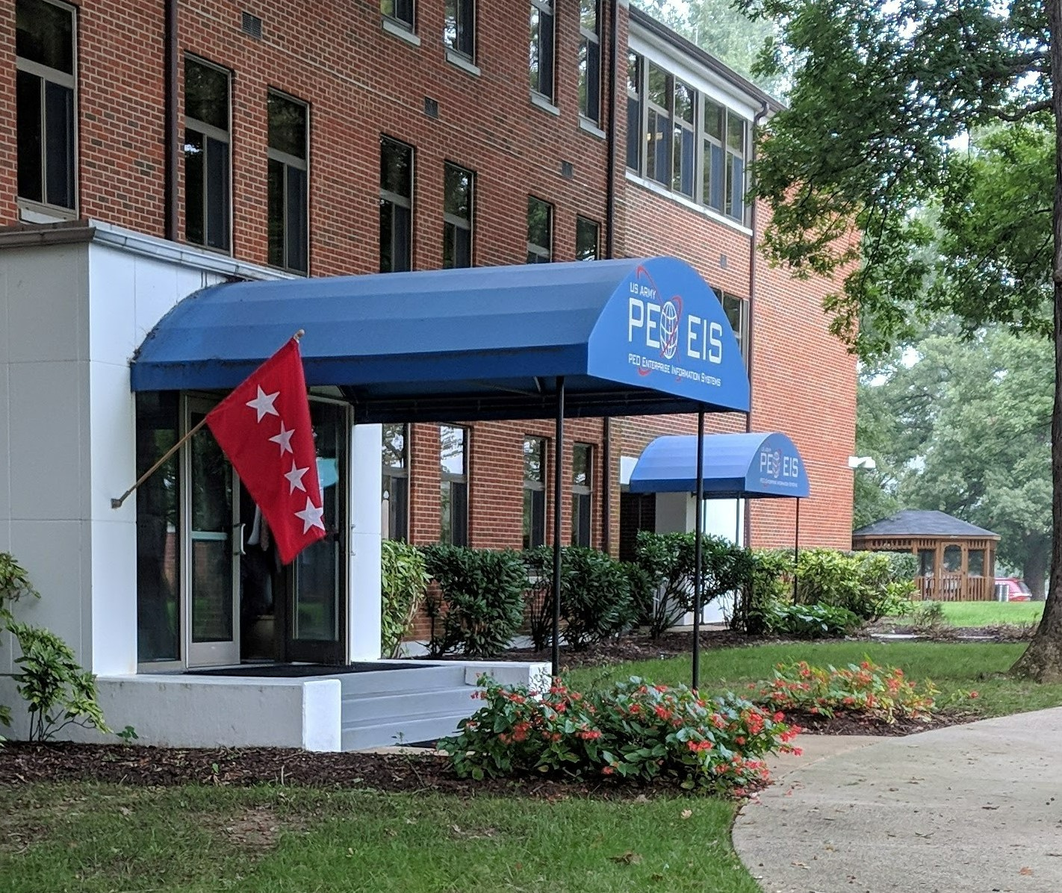

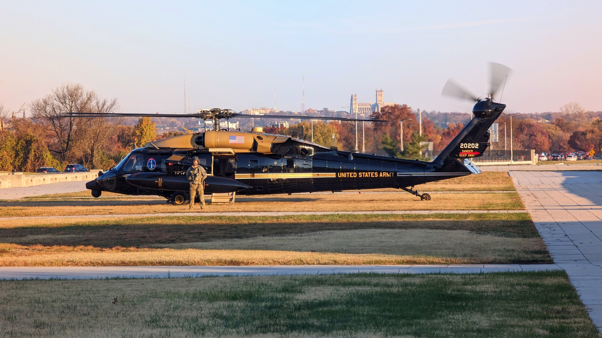

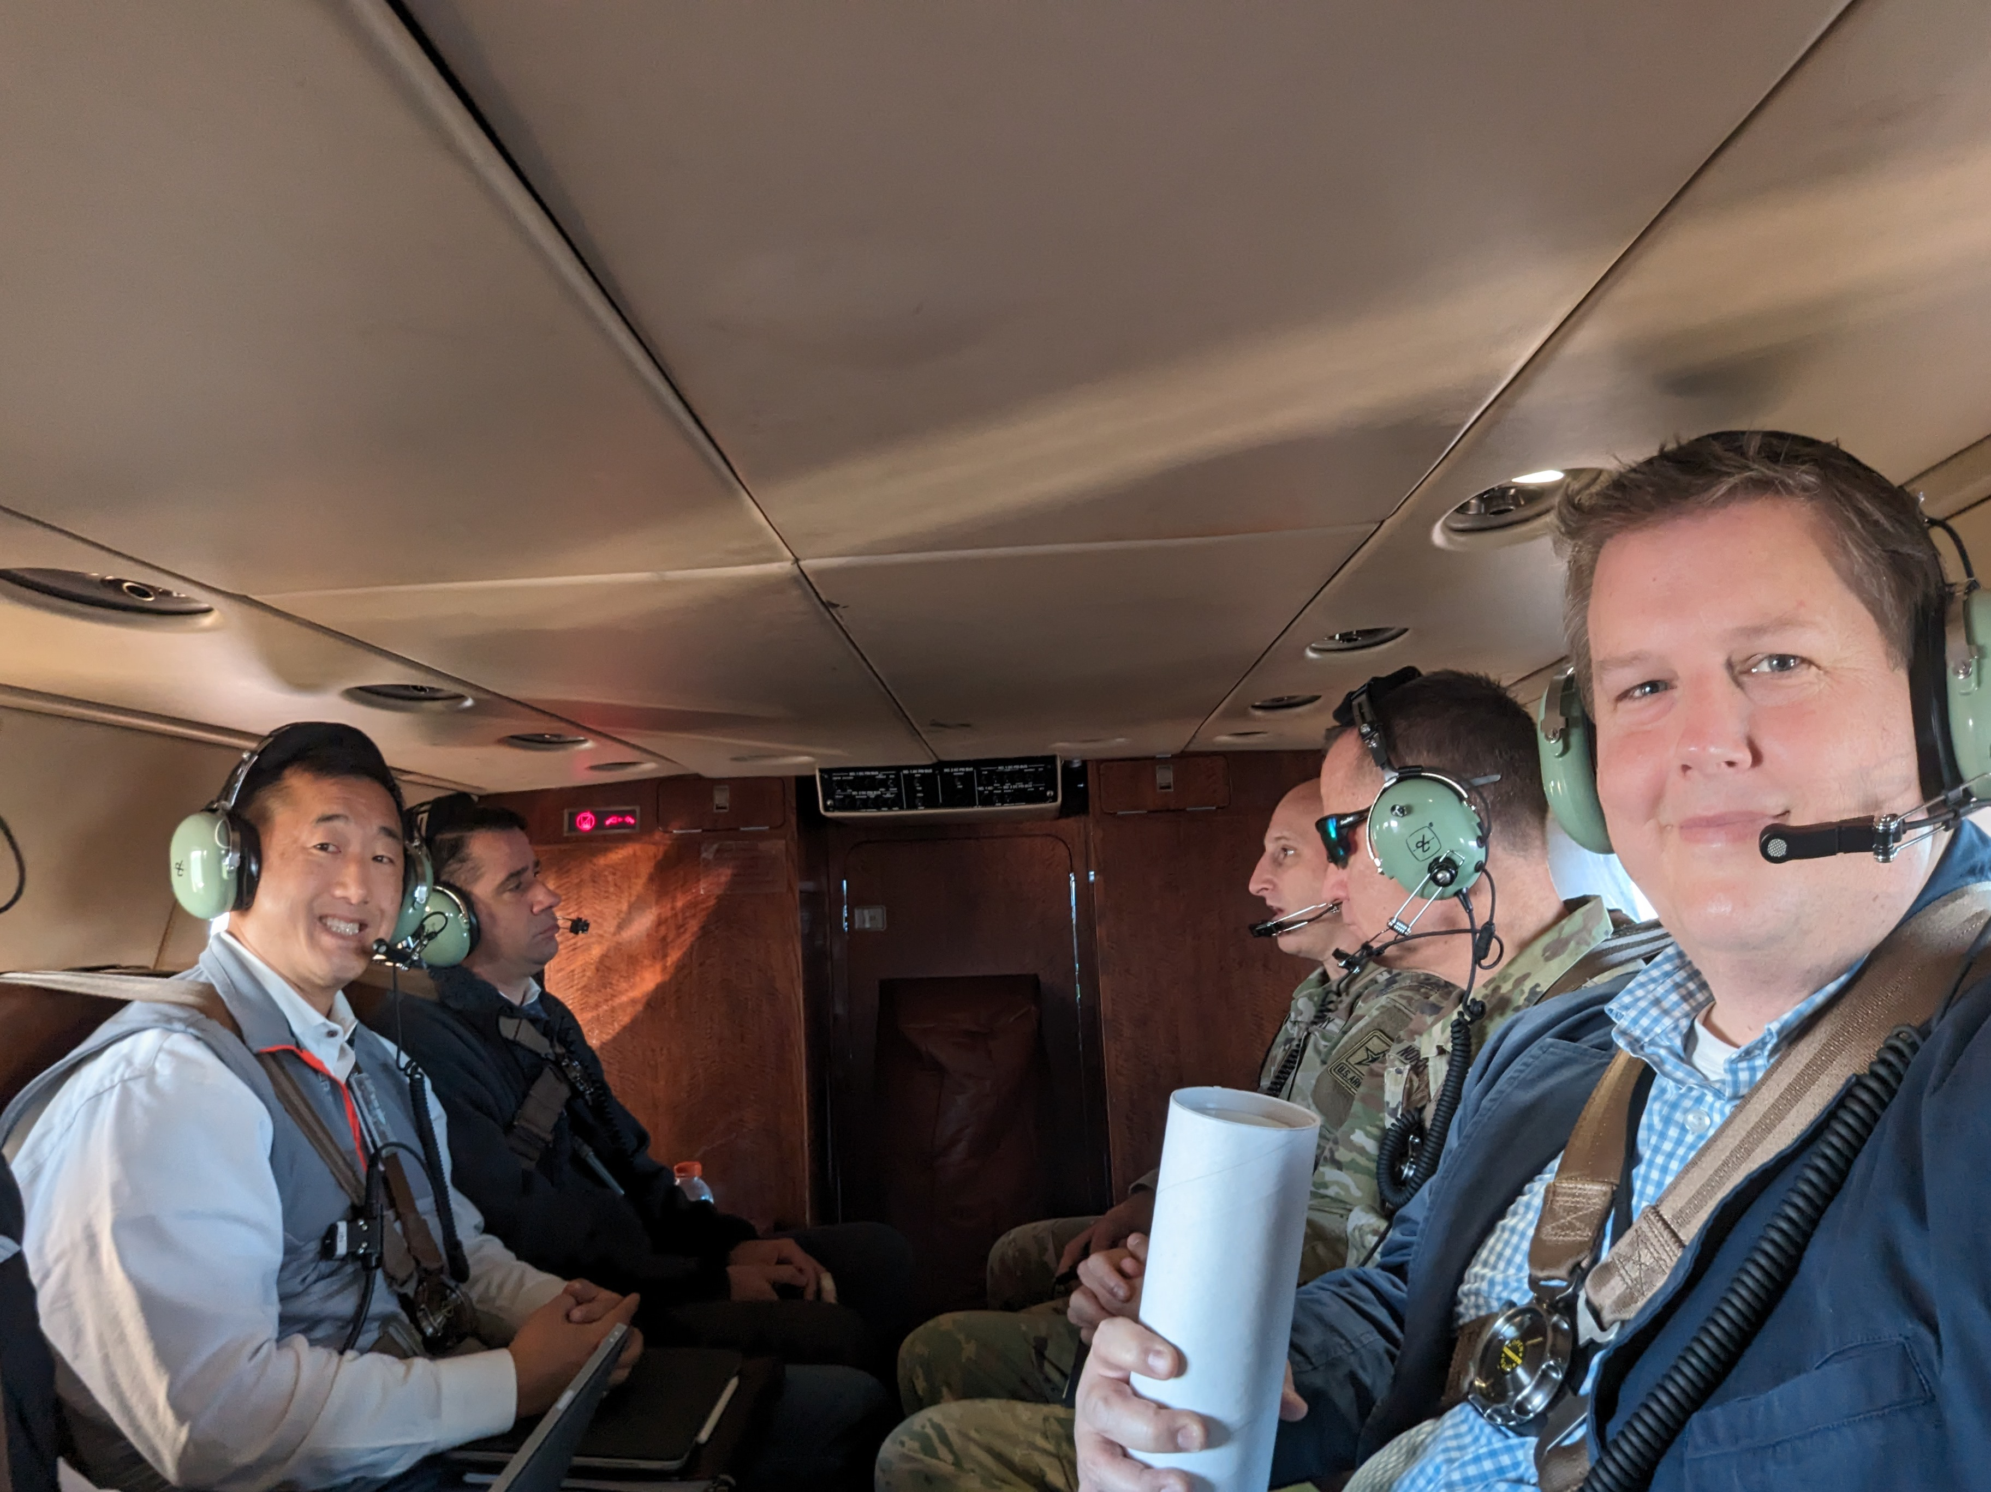










CIO
The journey to CIO, PEO EIS
GE
Ernst & Young
GE
CIO, PEO EIS
GE
Accenture
GE
GE Aircraft Engines
Virginia Tech
Grew up out West
Mech Eng.

Slide 3
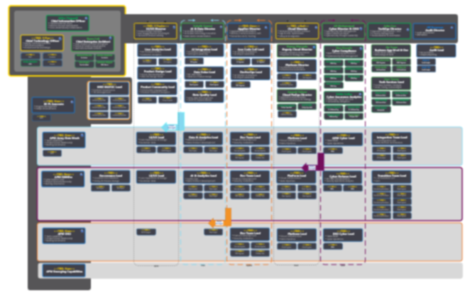
CIO
How it started, 19APR23
How it’s going, 14May24
New CIO Office Design
**cuts coming**
Cyber
  Operations
    Help Desk
    Knowledge Mgmt
    Mobile/Telephony
    Backup Services
  RMF
    RMF ISSMs
  Security Monitoring
    Security Engineers
Cloud
  Architect
  Project Manager
  FinOps
Data

Slide 4

USCYBERCOM / ARCYBER
CIO
Army C5ISR CSSP
RCC-CONUS CSSP
DISA CSSP
PNT CCSA CSSP
DLA CSSP
USAF CSSP
NBHDw
PEO EIS Converged Defense
PEO, AO
CIO
CTA
CISO, P-ISSM
NBHDw
Local Network, App, & Data Tiers
PM
ISSM
TMD
PM
ISSM
TMD
PM
ISSM
TMD
PM
ISSM
TMD
PM
ISSM
TMD
Local Defenders
Local Defenders
cArmy
AWS
SaaS
cArmy
Azure
ALTESS
COCO
XaaS
PNT
DLA
CloudOne
DISA

Slide 5
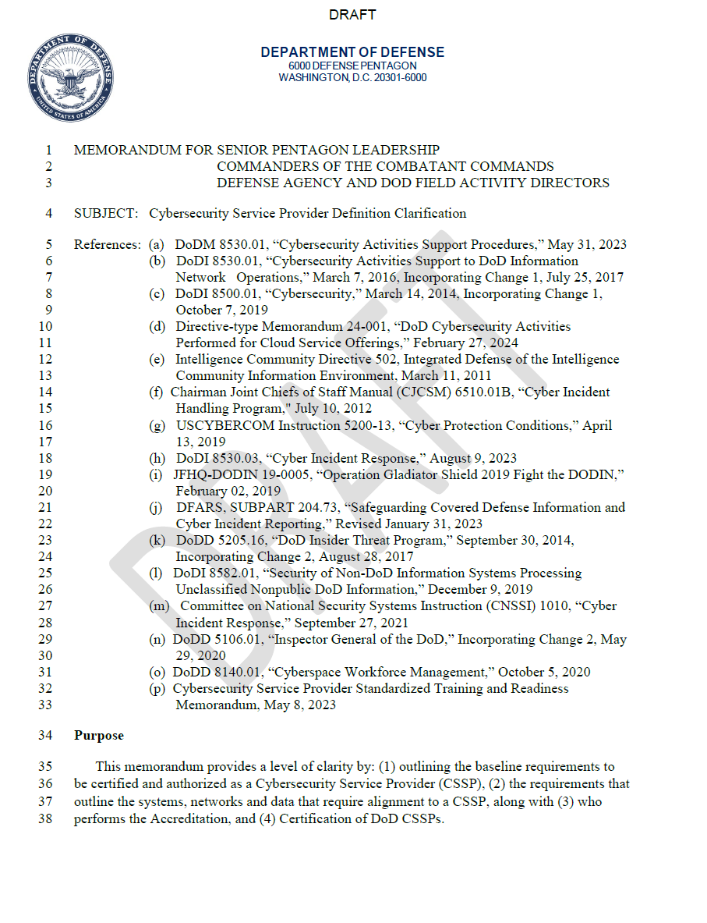



CIO
Hands on
keyboard krew
CSSP Definition Clarification
Local Defenders (n): The engineers, mission owners, and local entities that have direct access, or hands on keyboards, to the information that we are defending and are a critical aspect of any cyber defense team. [Line 67]
Local Defender Requirements Clarified
Local Response
Local Monitoring
Reporting
Collect, maintain, share all asset and vulnerability information with CSSP.
Identify, prioritize and take action on CSSP-provided security posture assessment and data.
Define adversarial activity using IP address, domain, TTP correlation analysis.
Communicate cybersecurity data and analysis with AO to support decision making.
Identify and report malware and supporting data to CSSP.
Shared cybersecurity monitoring activities across multiple architectural layers.
Tier 3 Local Network: Local Defenders; Tier 4 App & Data: Primarily Local Defenders.
Manage/govern commercial entities performing duties.
Provide audit and system logs to CSSPs.
Evaluate impact, Implement and status cybersecurity orders.
Collaborate with CSSP to share cyberspace incident-related information.
Monitor insider threat thresholds and report as needed.
Verify, validate and articulate the operational impact of incidents.
Implement passive countermeasures where feasible and notify the CSSP.
Retain all incident artifacts and documentation in accordance with disposition schedule.

Slide 6
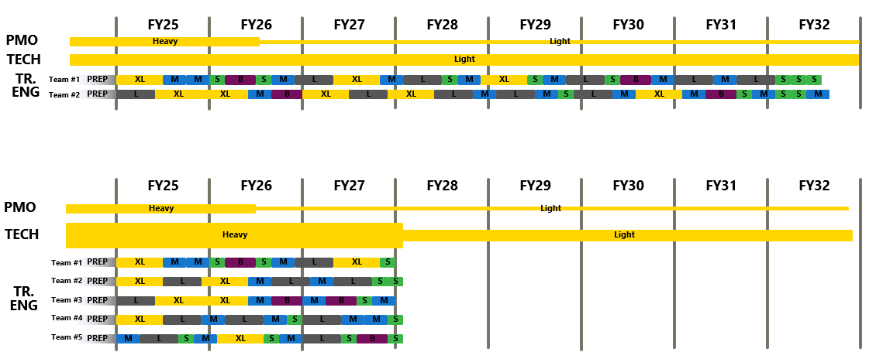
CIO
  When will NBHDw happen? Transition funding will help reduce overall schedule by 4.5 years.
Without Transition Funding
7.5 Years
With Transition Funding
3 Years

Slide 7
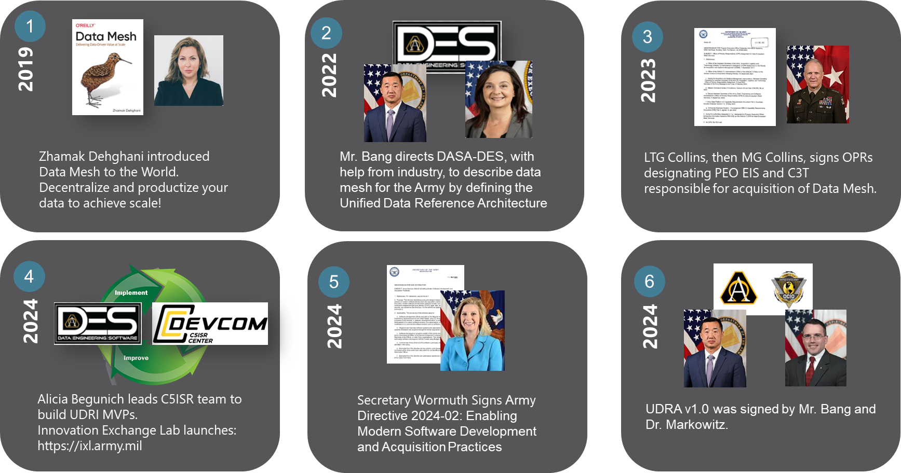
CIO

Slide 8
CIO
Data Product Catalog
Computational Governance
User Data & Collab. Services
API Broker Services
Data Product Orchestration
<TBD>.army.mil

Slide 9
CIO
As the PEO for PEO EIS, I need a DSO suite of capabilities that will provide transparency, trust and reliability to software delivery.
Agile Project Management
Easy Org Structure Aggregation
New ASA(ALT) Agile Metrics
Risk Mgmt
Config/Chg Mgmt
Repo &
Artifact Store
Version Control
Auditable
Army’s Data, Army’s Code
Easy Access and Use by Gov & Contractor
CI/CD Orchestrator
Multi-tool, multi-cloud capable
Easy Transparency
Automated Security
Software Comp. Analysis
SAST
DAST
APM Integration for Tasking
Automated Testing
Test Management & Analytics
End-to-End: Unit, Regression, Integration
APM Integration for Tasking

Slide 10
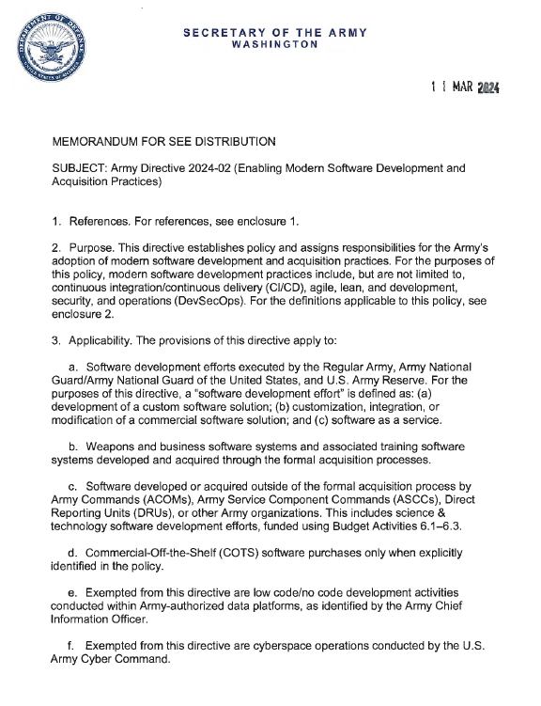



















CIO
DRAFT Modern Software Development (MSD) Multiple Award IDIQ
This directive establishes policy and assigns responsibilities for the Army’s adoption of modern software development and acquisition practices. For the purposes of this policy, modern software development practices include, but are not limited to, continuous integration/continuous delivery (Cl/CD), Agile, lean, and development, security, and operations (DevSecOps).
ARMY DIR 2024-02
Enabling Modern Software Development and Acquisition Practices
**RFI/RFP Coming Soon**
INDUSTRY
Tech Challenge
Or Demonstration
MSD IDIQ Pool
Program & Portfolio Level
Agile Rel. Train
Agile Rel. Train
Product Teams
Product Teams
ASA(ALT) Demand

Slide 11
CIO
GAMES
AND
Q + A

