Slide 1


GLOBAL FORCE INFORMATION MANAGEMENT (GFIM)
OUR DIGITAL MODERNIZATION JOURNEY
Every Soldier. Every Day.
DISTRIBUTION STATEMENT A. Approved for public release. Distribution is unlimited
May 14, 2024
Notes:
Proposed Voice Over: Joke/Icebreaker.

Slide 2
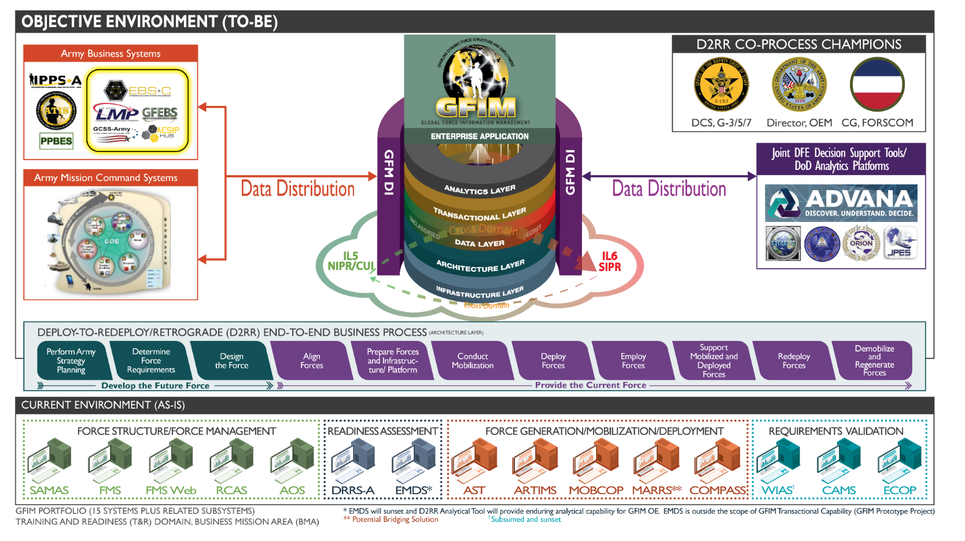
GLOBAL FORCE INFORMATION MANAGEMENT (GFIM)
Notes:
Proposed Voice Over: Good afternoon/morning, I’m Rob Porter and the current Product Director for the Global Force Information Management System (GFIM), we are one of modernization effort across the Army enterprise and the top Defense Business Priority for the Secretary of the Army. GFIM when delivered will subsume functionality in at least 15 Legacy systems and deliver a modernized system that will additionally eliminate swivel chair functions, provide capabilities never seen in Army software and ensure Global Force Management Data Initiative compliance data that is auditable. We recently converted over to the 5000.75
Many of you who are familiar with PEO EIS are familiar with current programs like IPPS-A, GCSS-Army, and Vantage, as well as emerging efforts like Army Data Platform 2.0, EBS-C and the recently Announced UDRA. All of these programs and systems are dependent on delivery of the Force Management/Structure Data, this is why a truly modernized systems is imperative. In close alignment with our Functional Leads in the G-3/5/7 we have executing using SAFe Agile and building an automated DevSecOps pipeline that will help modernize the way the PEO technically delivers for the Army to match the modernized business process provided by the customer.

Slide 3



PEO PILLARS
Speed
Simplicity
Excellence
Become Agile Practitioners to deliver earlier, faster and more frequently
Decompose, streamline and simplify. Remove programmatic clutter
Deliver better quality by testing every sprint, engaging customers earlier and using automated testing
Notes:
Proposed Voice Over: Recently the new PEO, Mr. Bill Hepworth identified three pillars we are focused on within all program and across the vast mission we have. Today I would like to talk with you about my journey and the one of GFIM, and how we have engaged with our industry partners to push the GFIM mission, PEO and Army forward in digital modernization. As you will see on the screen, Speed, Simplicity and Excellence are the pillars, I have underlined the words in each one that I think most apply to my focus and the direction of GFIM and I highly encourage all of you to apply them with your engagement with PEO programs as I think they are very much in line with where we need to drive as a community
Speed – Delivery, the demands of the Army are only speeding up and the ability to take requirement from start to finish in a rapid fashion is needed
Simplicity – Streamline, We are building and running some of the largest enterprise systems in the world within PEO, nothing we do is simple but the ability for it to appear simple if key.
Excellence – Deliver, At the end of the day we are all judge on our ability to delver, for use delivering without quality is not excellence and that is the mark we are striving for.

Slide 4
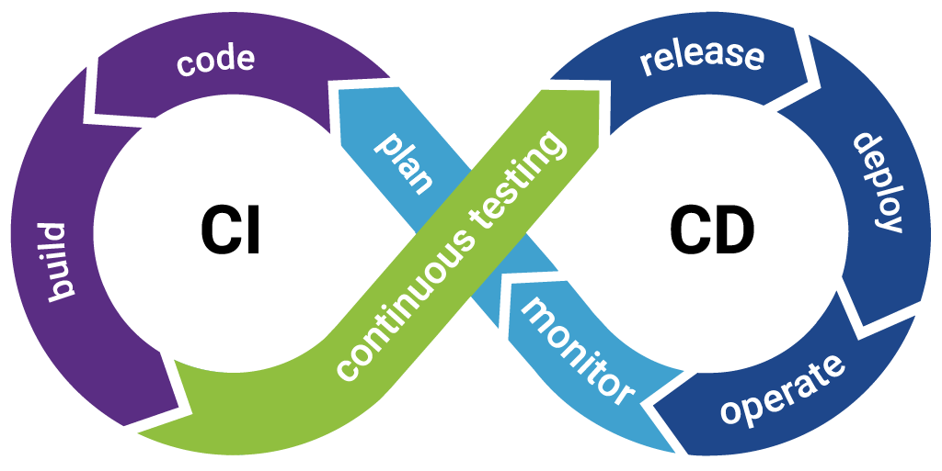
GFIM DEVELOPMENT & BEYOND
Design, Architect, Develop
Commit
Harden, Scan, Artifact Creation
Testing
Unit, Load, Penetration
Production Deployment
Continuous Integration / Continuous Development
Notes:
Proposed Voice Over: So far, I have discussed effort in development, how can we get from dev to customer in the shortest amount of time. None of the efforts end there, everything we do is really built for beyond deployments, as the Army moves past Agile adoption to DevSecOps and CI/CD we are also looking for ways to address what has traditionally been known as the sustainment phase, the cost of maintaining technology, managing a helpdesk and ensuring the security of our deployed systems is ever increasing and must engage and utilize technologies that provide efficiencies in these areas as well.
From security software, to digital adoption technology aimed at easing the burden of help desks we within the acquisition community and industry together need to build business cases for how the costs and uses of these technology can gain the Army efficiency.

Slide 5
INCREASING SPEED OF DELIVERY
Design, Architect, Develop
Commit
Harden, Scan, Artifact Creation
Testing
Unit, Load, Penetration
Production Deployment
Speed
Become Agile Practitioners to deliver earlier, faster and more frequently
Design, Architect, Develop
Commit
Harden, Scan, Artifact Creation
Testing
Unit, Load, Penetration
Production Deployment
Notes:
Proposed Voice Over: Since 2020 PEO EIS has committed to adopting Agile practices, these efforts serve as a building block to culture change informing the Army’s functional communities on better ways to develop capabilities. As the Army and PEO increase adoption a challenge emerged, how would we not only develop in an agile fashion but DELIVER in and Agile fashion.
Prior to my current role I was the PD for the GFEBS System, the Army’s Financial ERP in sustainment, our agile path there increase accuracy in delivery but not efficiency. The technical capabilities available for a system built over a decade ago made for tough decisions, the balance of Tech Debt, needed functional capabilities and auditability in a resource constrained environment hindered modernization. You can see at the top of this slide how that looked, design, architect and develop went quickly, then we held on deployment till the rest of the process would be ready in some cases months.
In my current role with GFIM we are laying the building blocks to not only deliver agilely but utilize a DevSecOps pipeline that is adaptable to meet future technology integrations and requirements. This includes the user of Kubernetes, automated, code, application, and hardware scans as well as the automated unit, regression, and scenario-based testing. This has allowed us to not only develop agilely and quickly but deliver as across the last four months we have deployed capability at the end of each sprint (8) to a sandbox environment intended to mimic a production environment, these software previews are available to our functional community, and they are able to access and see recent capabilities as they are completed.

Slide 6

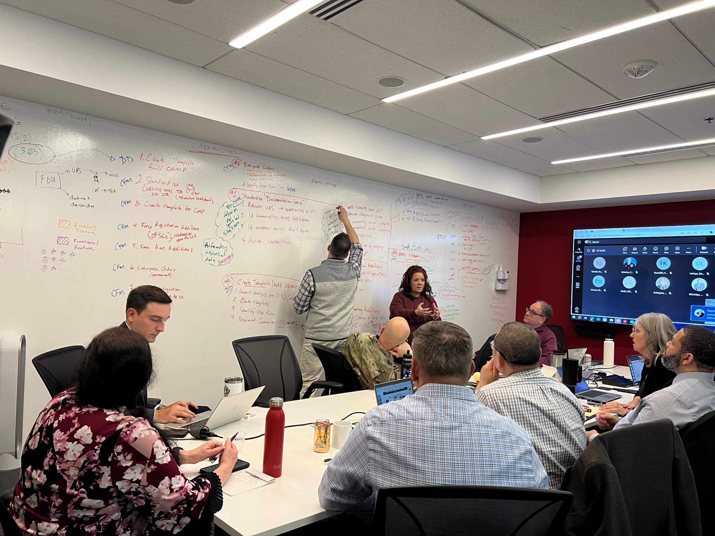
CUSTOMER ENGAGEMENT THROUGH AGILE
Notes:
Proposed Voice Over: Recent policy has caught up to how we have been operating over the past few years, making he process streamlines and even pushing forward beyond where we currently are as a group to concepts like Lean, DevSecOps, and CI/CD. One item I find critical element with the Secretary of the Army’s Policy I believe to be paramount is the functional and active users' engagement and involvement. Along with all the great technology and concepts we are applying within GFIM the greatest strength we have is our relationship and involvement from the leads and actual users of our system when deployed. On the screen you can see picture of our recent Solution Planning Event, to date it has been one of our most successful events, that is because we have tightened the feedback loop from what the customer is asking for, what we are developing and validation, the Pipeline we have built allows us to do that but a pipeline without engagement like this from your customer does not push the mission forward.
I know it is never that easy and I will say over my time in GFIM we have worked day in and day out over nine months to get to this point, it starts with understanding and establishing boundaries, I am the furthest thing from a Force Manager the Army has but listening and learning the functional processes while being able to lead delivery is a great accelerant.

Slide 7
GAINING EFFICIENCIES THROUGHOUT AGILE
“Modern software development requires adoption of a Continuous Integration/Continuous Delivery (Cl/CD) model where software is continuously and iteratively developed and upgraded throughout the acquisition lifecycle.”
- Hon. Douglas R. Bush, ASA ALT
Simplicity
“Modern software development practices include, but are not limited to, continuous integration/continuous delivery (Cl/CD), agile, lean, and development, security, and operations (DevSecOps).”
- Hon. Christine E. Wormuth, SECARMY
Decompose, streamline and simplify. Remove programmatic clutter
Notes:
Proposed Voice Over: As I mentioned previously many of us have been utilizing concepts like agile, CI/CD, DevSecOps for years but like any cultural change to make marked change guidance and direction from senior leaders is needed. We have been receiving this guidance and quite rapidly over the last 12-18 months within the Department of the Army. This included Software Funding Memorandum from ASA ALT and the Directive Signed by Secretary Wormuth on Modern Software Development and Acquisition Practices.
These policies not only acknowledge the digital modernization efforts of the last few year but are the artifact within our culture we can use as a springboard to move out and execute and accelerate delivery, in a sense the streamlining our processes and aligning the processes with those modern technologies needed to keep the Army capabilities relevant.

Slide 8
























EXCELLENCE FROM INDUSTRY ENGAGEMENT
Excellence
Deliver better quality by testing every sprint, engaging customers earlier and using automated testing
Notes:
Proposed Voice Over: As I think about the third pillar it’s where I see the greatest need for change, change in the way we evaluate technology and tools, change in the way we engage with you in industry on capability needs and change in the way we deliver to not only meet the needs and mission we have currently but the flexibility to change and meet the mission of tomorrow.
While GFIM will always look for improvement and efficiency our we are well on our way, and while agile is not new to us in the PEO or Army the digital transformation journey, we are on to enable and improve upon our efforts is just beginning. As each of you leave here and have engagements with my counterparts across the PEO and Army, I ask you to thinking about the ways that you can help us maintain flexibility, modernize solutions and gain efficiencies in the way we deliver to enable the modernization of the Army’s Processes and operations.

Slide 9




THE ARMY RELIES ON PEO EIS
COMPANY/USARMYPEOEIS
PEO.EIS
@PEOEISPAOFFICE
WWW.EIS.ARMY.MIL
@USARMY.PEOEIS
Notes:
Questions?

Slide 10


