Slide 1
PEO EIS: THE NEXT CHAPTER
Feb. 28, 2024 | AFCEA Belvoir Luncheon
"Every failure is a chance to learn." – Bill Hepworth

Slide 2
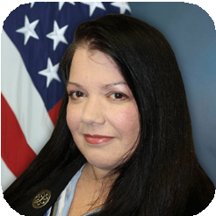
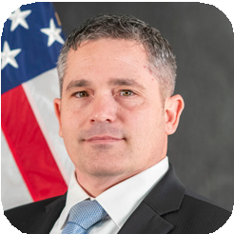
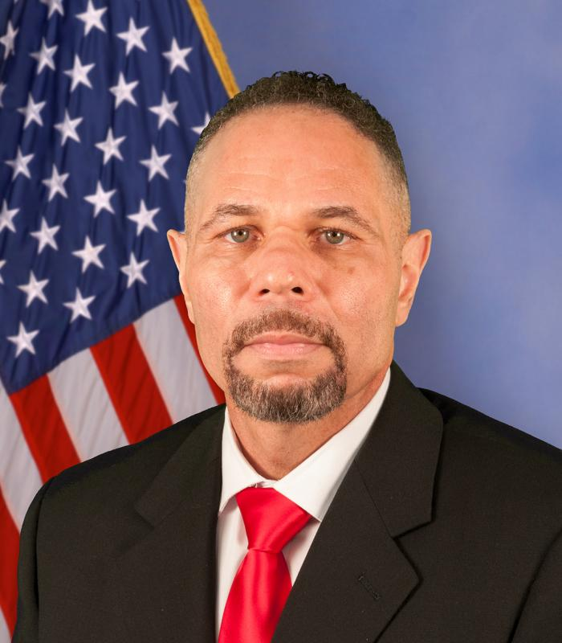
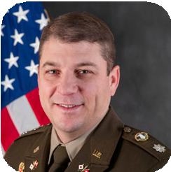
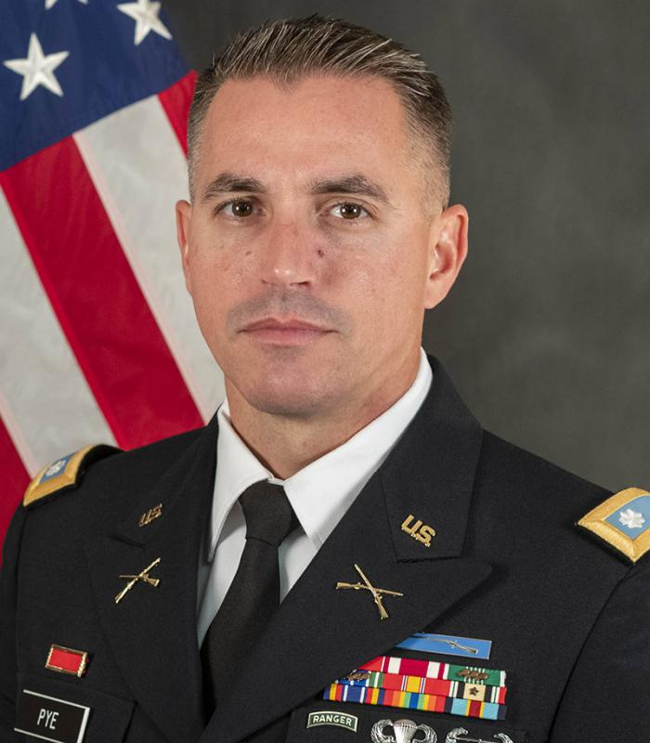
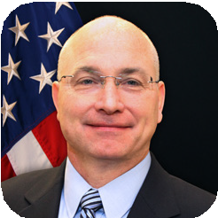
ORGANIZATIONAL CHART
Updated 02.23.24
MR. BRIAN RAFTERY
PROJECT MANAGER
Army Data and Analytics Platforms (ARDAP)
LTC LJ FREELAND
PRODUCT MANAGER
Army Data Platform (ADP)
MS. ELISSA ZADROZNY
PRODUCT LEAD
Logistics Information Systems (LIS)
MR. ROBERT PORTER
PRODUCT LEAD
Global Force Information Management (GFIM)
MR. TIMOTHY HALE
PRODUCT MANAGER
Army Training Information Systems (ATIS)
MR. MICHAEL GORMLEY
ACTING PROJECT MANAGER
Enterprise Business Systems – Convergence (EBS-C)
MR. JOHN CRONE
PRODUCT DIRECTOR
Army Human Resource Systems (AHRS)
MR. KEVIN CURRY
PROJECT MANAGER
Defense Integrated Business Systems (DIBS)
MR. STEVE EDSALL
PRODUCT MANAGER
Army Contract Writing System (ACWS)
MR. JAMES WINBUSH
ACTING PRODUCT DIRECTOR
Global Combat Support System – Army (GCSS-A)
MR. CARLTON WHITE
PRODUCT DIRECTOR
General Fund Enterprise Business System (GFEBS)
MR. GABRIEL SALIBA
PRODUCT LEAD
Logistics Modernization Program (LMP)
MR. KEITH BAYLOR
PRODUCT LEAD
ArmyIgnitED
MS. KELLY RUTHERFORD
PRODUCT LEAD
Foreign Military Sales –
Army Case Execution
System (FMS-ACES)
MR. BILL HEPWORTH
Program Executive Officer
MR. ARIC SHERWOOD
Acting Assistant PEO
COL ROBERT J. MIKESH JR.
PROJECT MANAGER
Integrated Personnel and Pay System – Army (IPPS-A)
LTC RYAN MARTIN
PRODUCT MANAGER
IPPS-A Increment II
(IPPS-A Inc II)
LTC BRANDON PYE
ACTING PRODUCT LEAD
Accessions Information
Environment (AIE)
MR. STEVEN REICHARD
PRODUCT LEAD
Medical Communications
for Combat Casualty Care (MC4)
MR. SAJJAN (SAJ) GEORGE
PRODUCT LEAD
Reserve Component Automation Systems/ Force Management System (RCAS/FMS)
MR. ROB SCHADEY
Acting Deputy Program
Executive Officer
MR. REGINALD SHUFORD
PROJECT DIRECTOR
Enterprise Services (ES)
MR. BOYD WILLIAMS
PRODUCT DIRECTOR
Acquisition, Logistics & Technology Enterprise Systems & Services (ALTESS)
MR. GW BURNSIDE II
PRODUCT LEAD
Army Enterprise Staff
Management System (AESMS)
MR. BRENT THOMAS
PRODUCT LEAD
Human Resource Systems (HRS)
MS. SARAH MULLINS
PRODUCT LEAD
Computer Hardware Enterprise Software & Solutions (CHESS)
MR. PALMER MITCHELL
PRODUCT LEAD
Enterprise
Computing (EC)
MR. THOMAS CURRAN
PRODUCT LEAD
MilTech
MR. JOHN HOWELL
Chief of Staff
MR. ARIC SHERWOOD
Acquisition Innovation Directorate
MR. LAWRENCE SILAS
Acquisition Logistics Property Management
MR. ADAM BROSS
Business Management
MR. MICHAEL CHAPPELL
Chief Information Office
MS. SARAH STEENBERGE
Human Resources
MR. KEN WOJCIK
Plans & Operations
MS. TARA CLEMENTS
Strategic Communication
HEADQUARTERS STAFF DIRECTORS

Slide 3
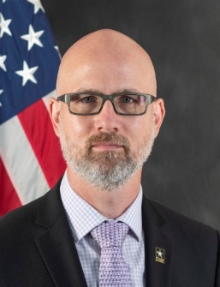
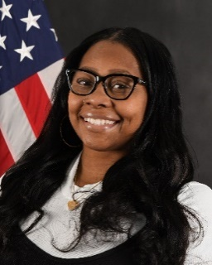
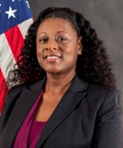
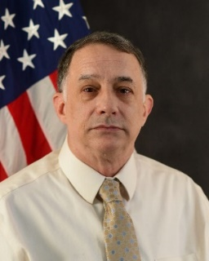
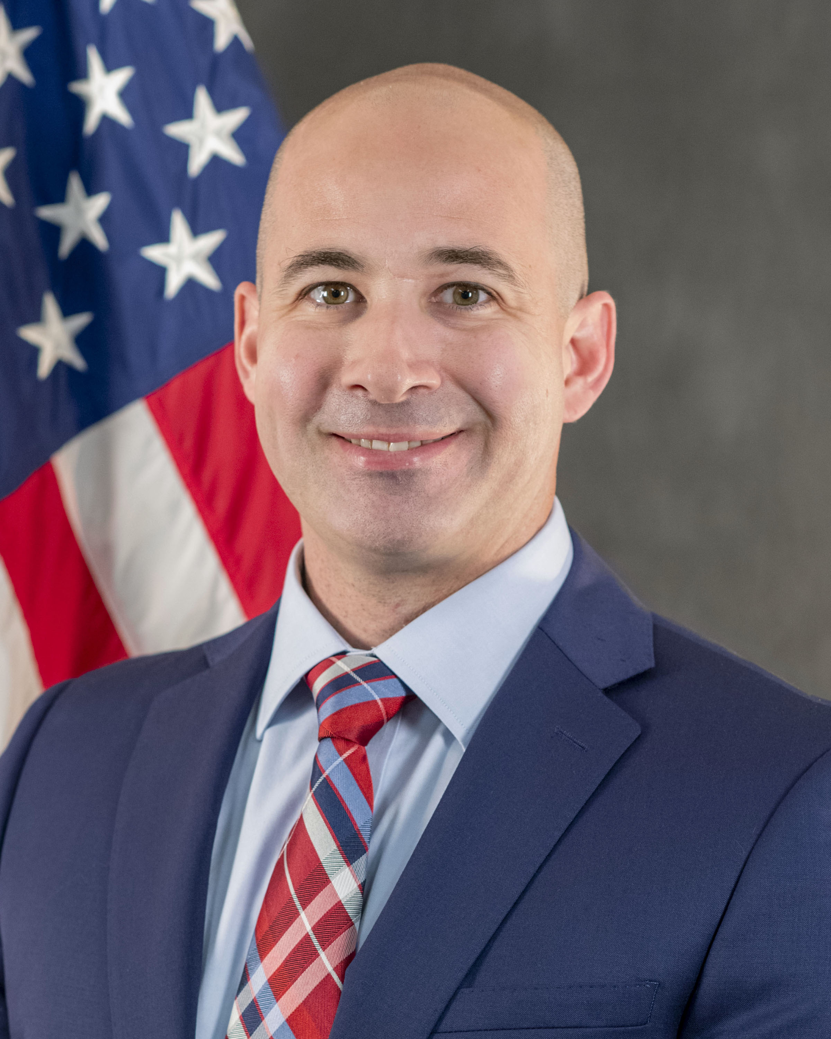
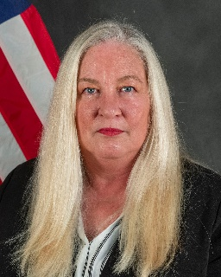
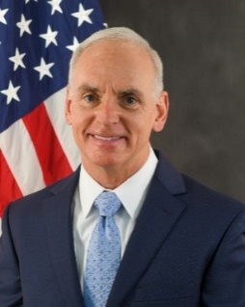
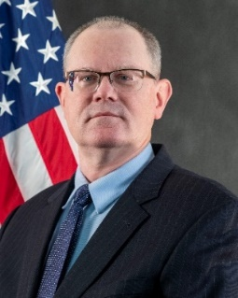
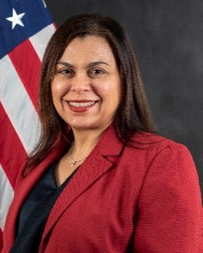
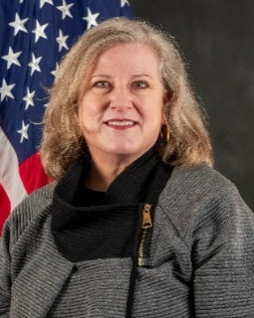
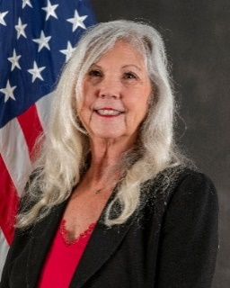
ORGANIZATION
Aric Sherwood
Director
Timica Arthur
Executive Assistant
Monica Wilkins
Scrum Master
Mike Hildebrandt
Acquisition Analyst, Ops, PMRT
Patrick Colleran
Contracts Lead
Karen Monahan
Acquisition Manager
VACANT
Acquisition Specialist
Kyle Burke
OTA Expert
Arthur Clark
Acquisition Lead
VACANT
Agilist x 2
Enid Sanchez-Bubb
Blue Team
VACANT
Acquisition Analyst, IPPS-A, ARDAP. ES
VACANT
Acquisition Analyst, DIBS, EBS-C
Simone Acha
Blue Team
Krystal Ange
Blue Team
GOV
CTR

Slide 4
WHAT IS CHANGING?
Agile journey
Contracting
Testing
Small Business Innovation Research (SBIR)

Slide 5
WHAT IS STAYING THE SAME?
Maintaining acquisition rigor
Collaborating with industry

Slide 6
WHAT WE NEED FROM YOU
Become versed in SAFe/Agile
Engage with contract partners to inform how we can best incentivize performance
Best practices for industry days
Feedback on how we’re doing with team integration

Slide 7
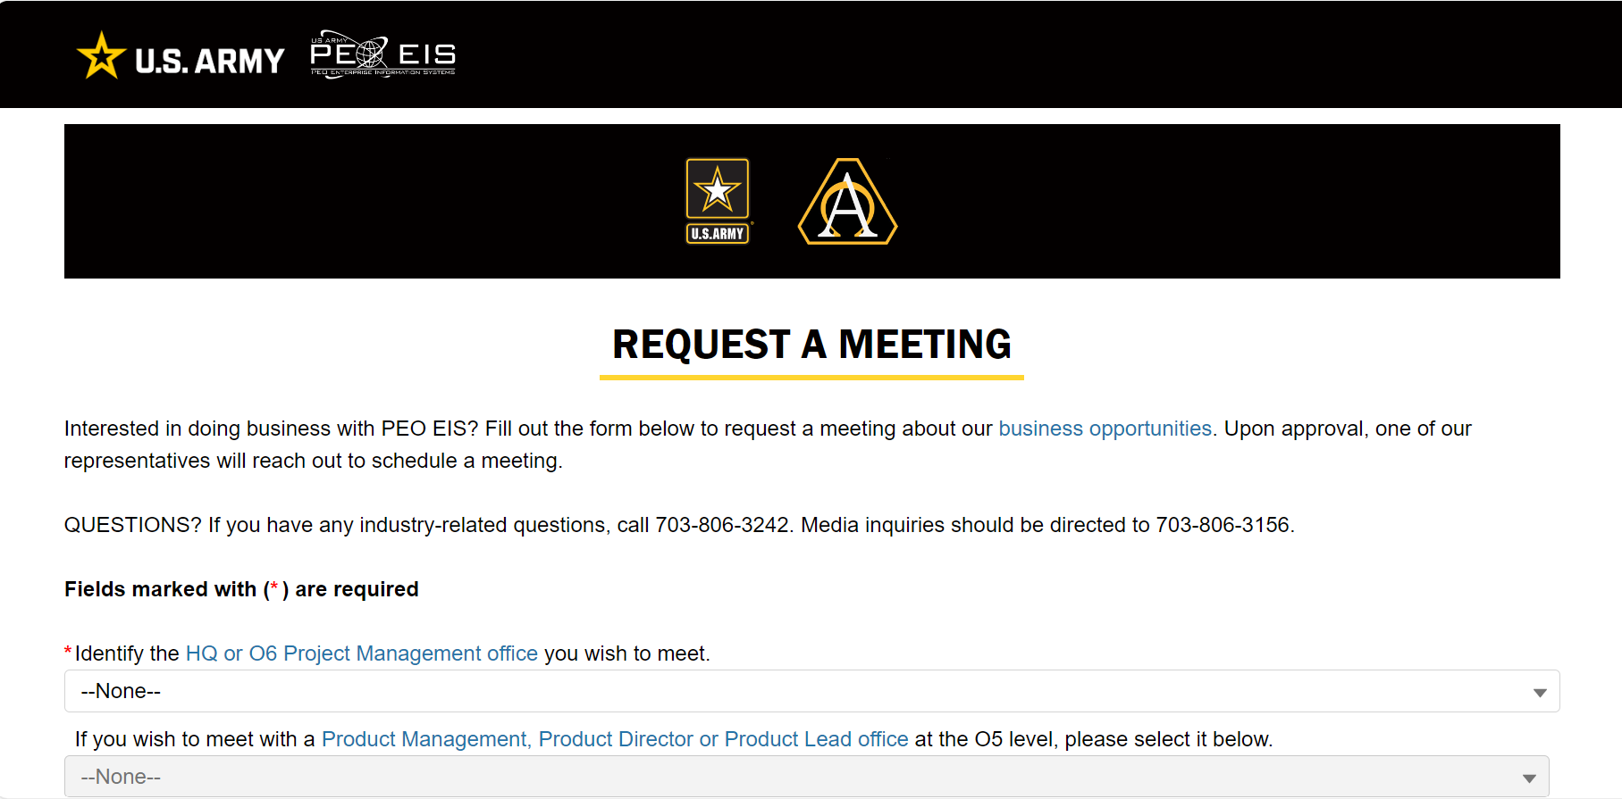
RESOURCES
Request a Meeting
eis.army.mil/meet

Slide 8
QUESTIONS
“Don’t acquisition my Agile” – Bill Hepworth, PEO EIS

